Slide 1
Improving Healthcare: Hospital Emergency
and Suicide Attempt
Team 2: Pete Gray, Pratik Chandwani, Conrard Giresse Tetsassi Feugmo
York University CSML 1030

Slide 2



Slide 3
Agenda
Introduction
Findings of Hospital Patient survival dataset
Findings of Mexico’s Cause of Death dataset
Interpretability
Conclusion
Recommendations
Future work

Slide 4


CAMH: The Centre for Addiction and Mental Health
Canada’s largest mental health teaching hospital
CAMH has 90 distinct clinical services across inpatient, outpatient, day treatment, and partial hospitalization models
CAMH offers outstanding clinical care to more than 37,000 patients each year
Expert training to health care professionals and scientists
Develops innovative health promotion and prevention strategies
Advocates on public policy issues at all levels of government

Slide 5

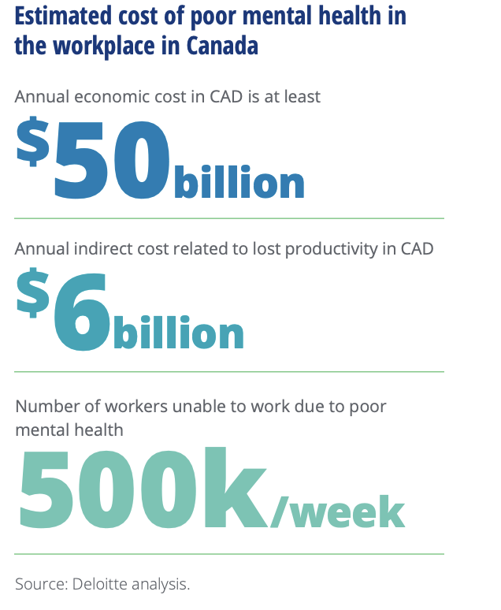
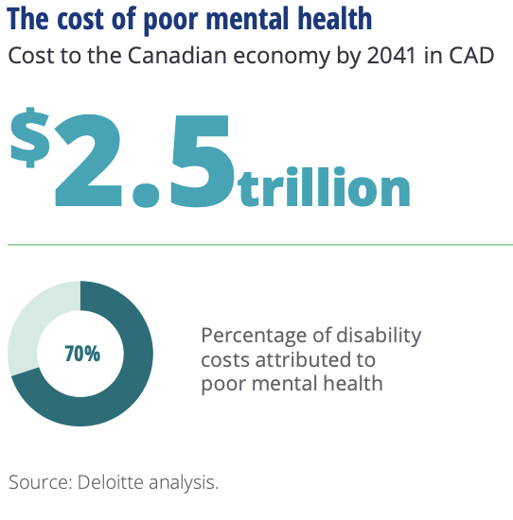

Statistic: Mental illness

Slide 6
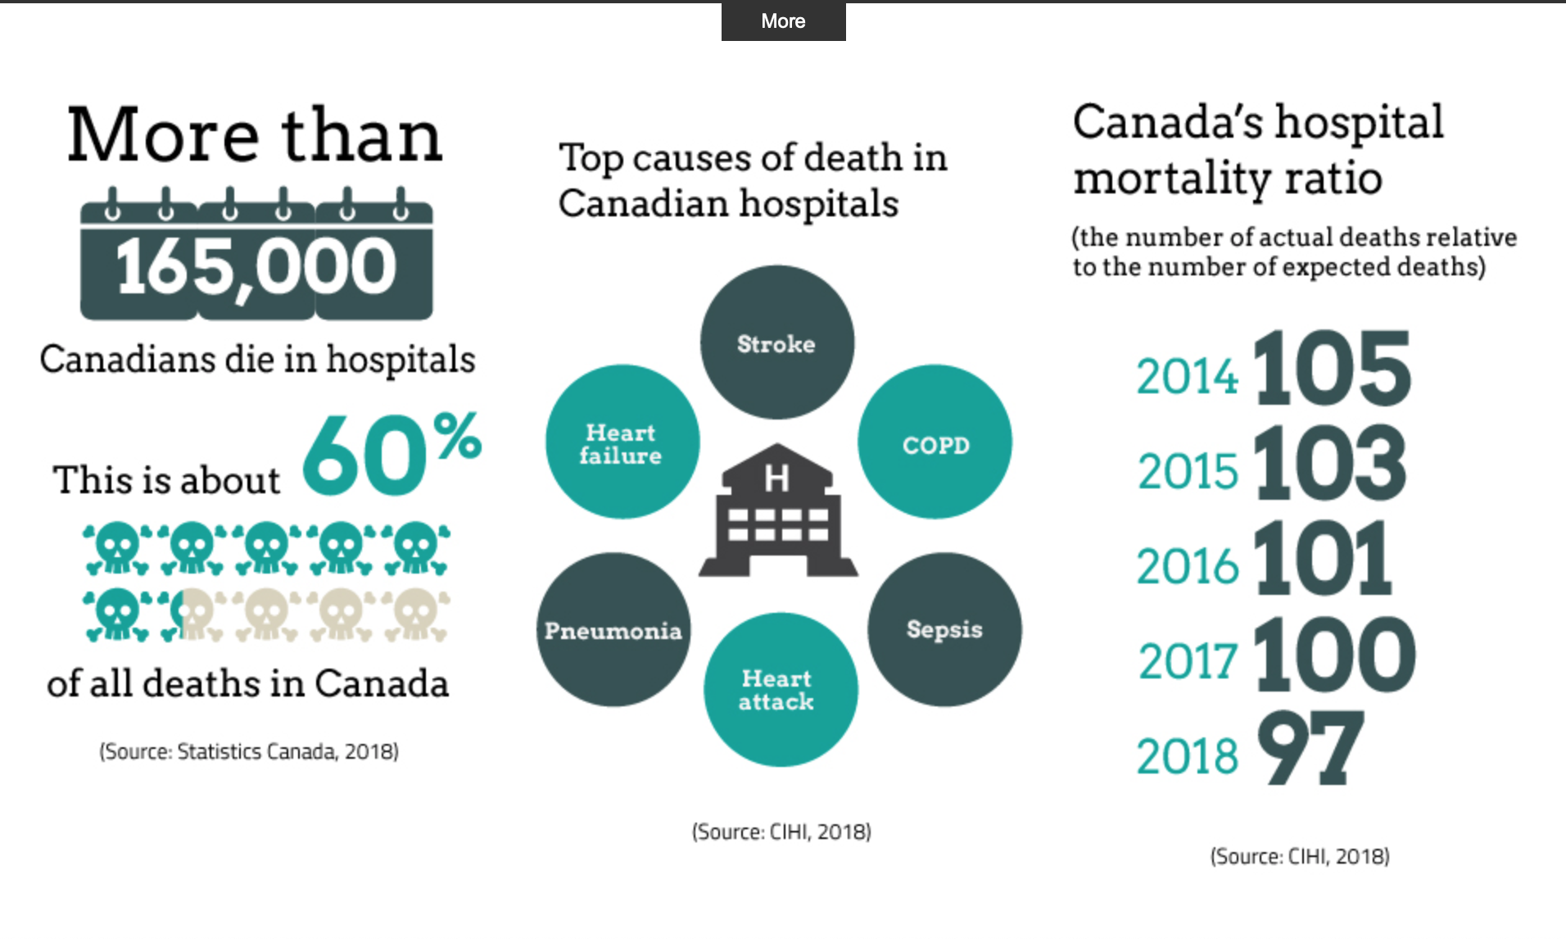
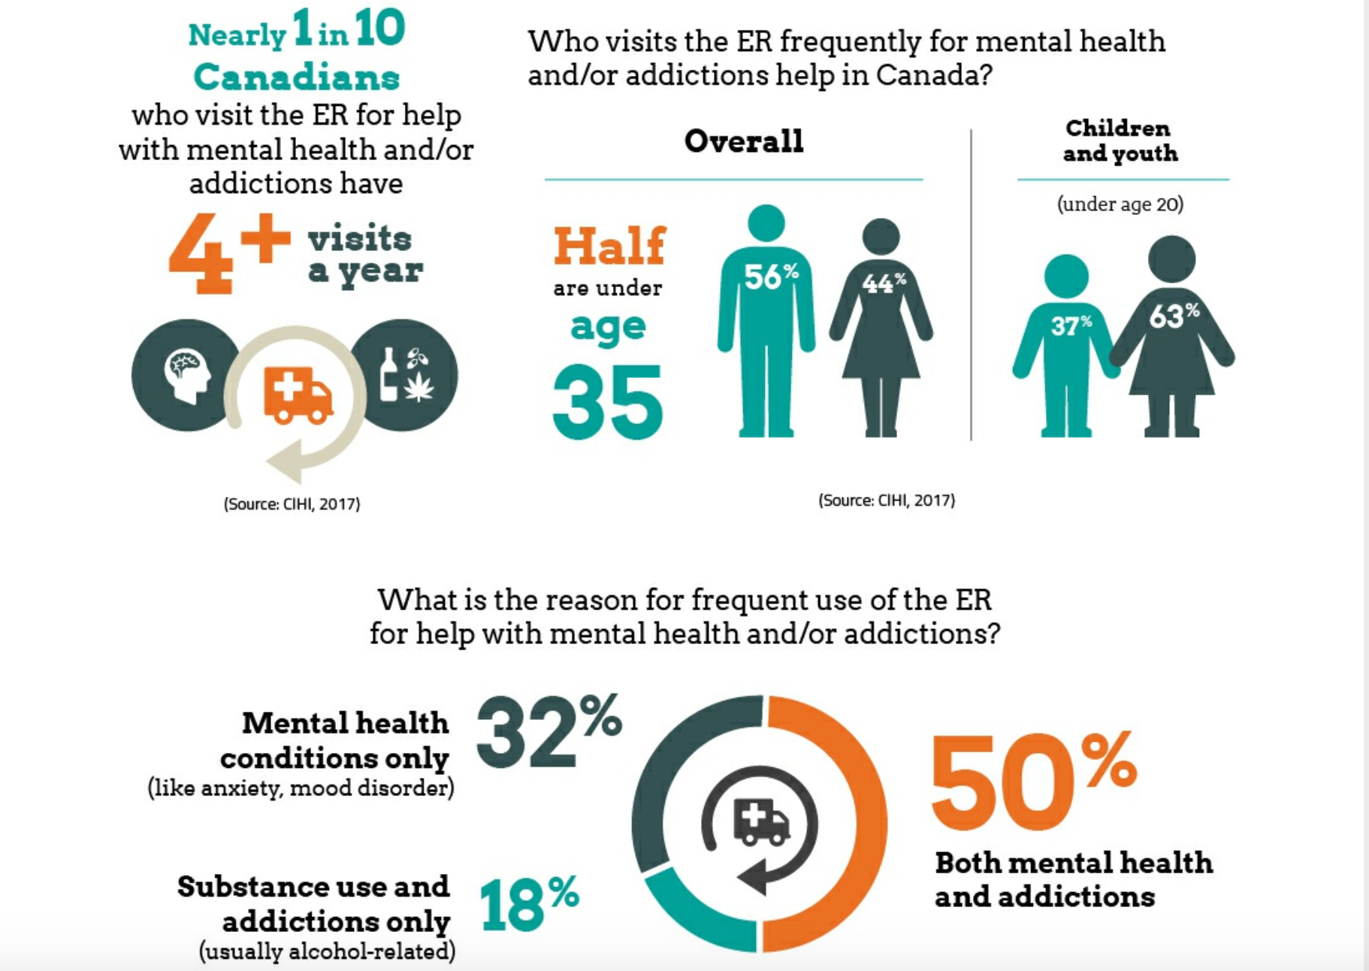
Statistic: Hospital and Emergencies

Slide 7
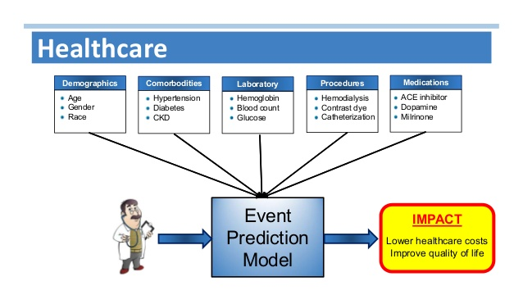
Strategy
machine-learning-for-survival-analysis-4-638.jpg

Slide 8
2 Datasets:
Clinical and demographic data to improve patient survival at Emergency (Kaggle)
Cause of death data from Mexico to understand those related to suicide (Provided by CAMH)

Slide 9
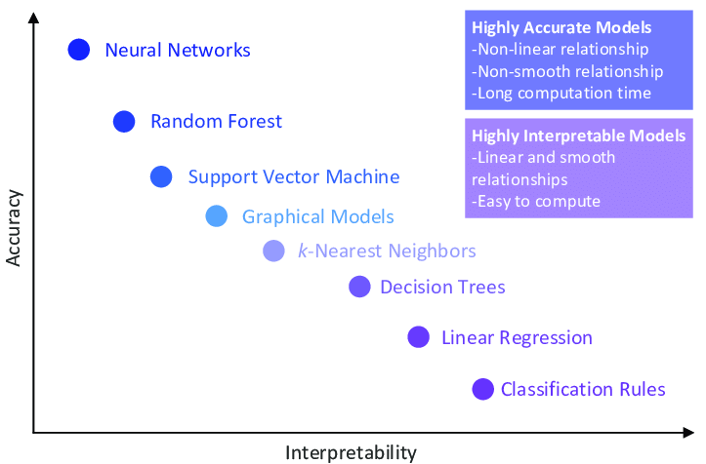
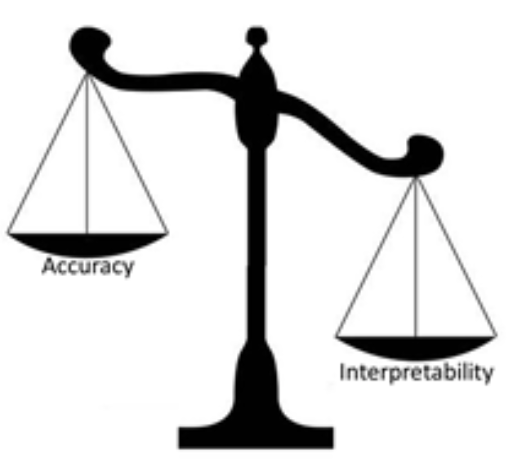
Healthcare: Accuracy VS Interpretability

Slide 10
Our Pipeline
100%
100%
100%
100%
100%
100%
EDA
Features Engineering
Selection
Modeling
Analysis
Recommendation
Exploratory Data Analysis
Finds features correlated to the target
Label the data and the values
Imputation ( KNN, Iterative)
Create target Feature
Features section.
Collinear features
STD =0
Less Important features by random forest
RFE with the 10 top highest rank
LightGBM
Decision Tree
Random Forest
Identify the most Important prediction
Demographic vs Clinical
Map road For make Decision

Slide 11
Dataset 1:
Improve Patient survival at Hospital

Slide 12
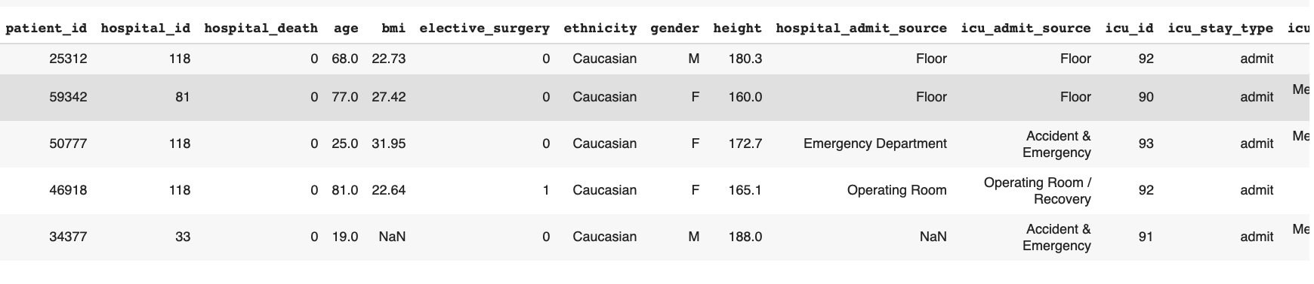
Global Women in Data Science (WiDS) Datathon 2020 (Kaggle)
Clinical and Demographic Data
91713 entries and 189 attributes.
First 24 hours of intensive care to predict patient survival
Classification Problem
Target

Slide 13
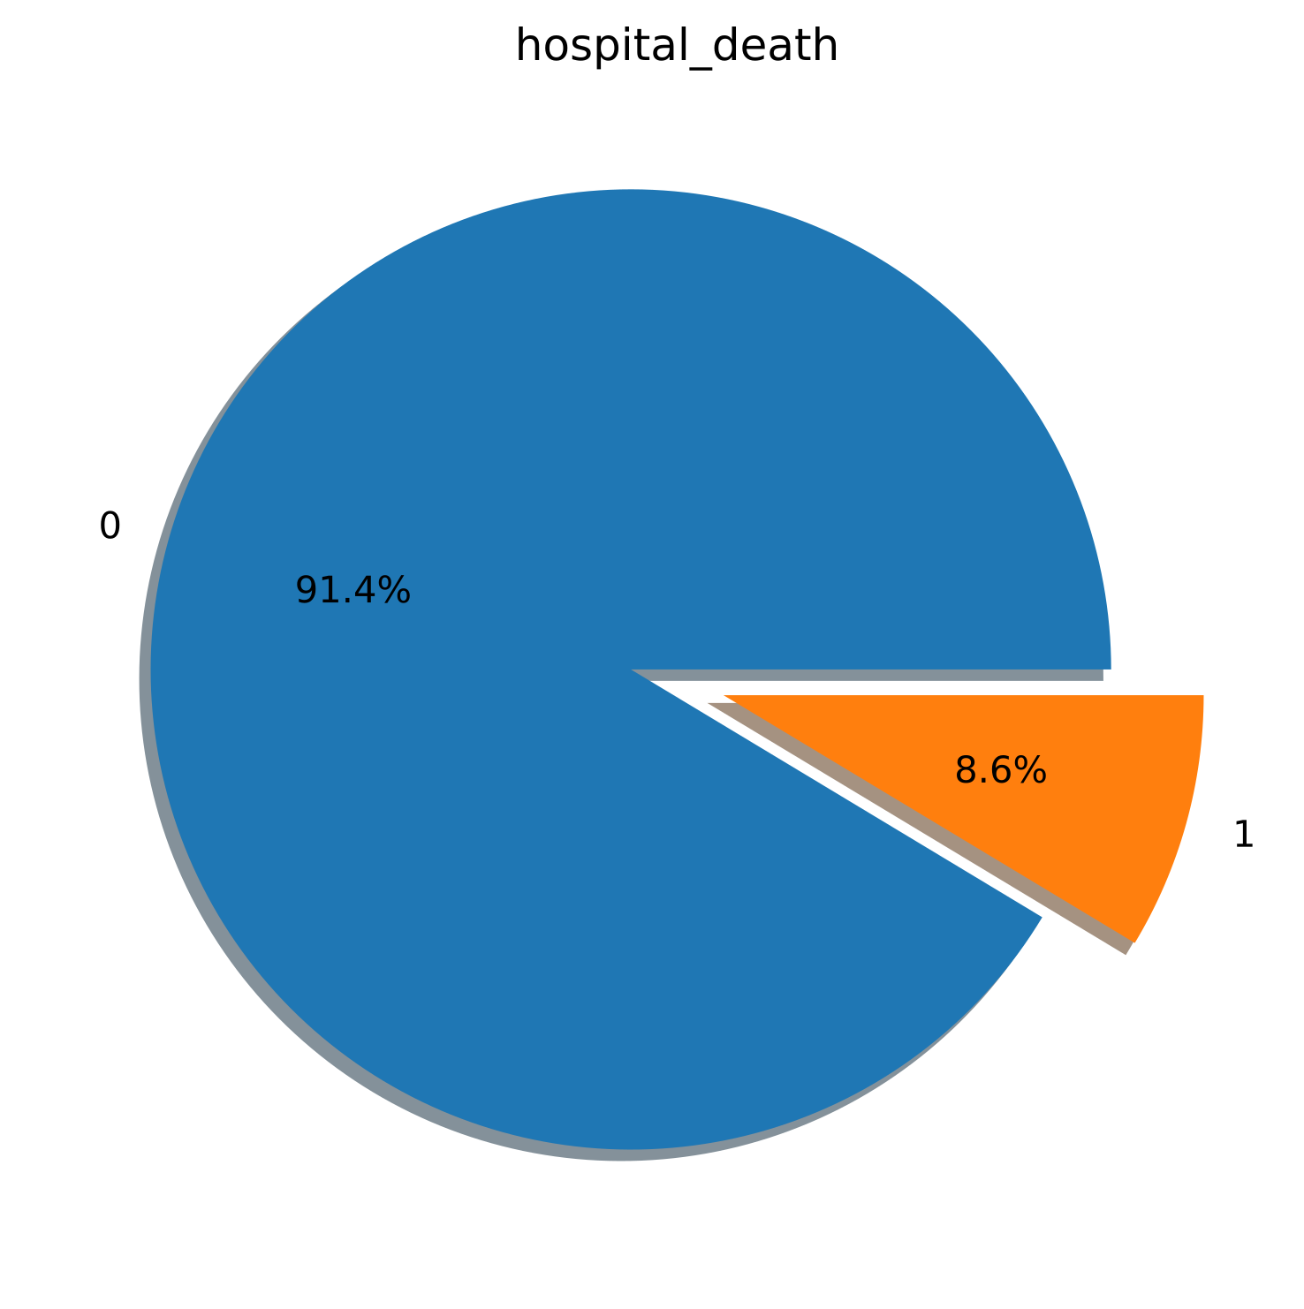
Death Rate
Dataset was unbalanced

Slide 14
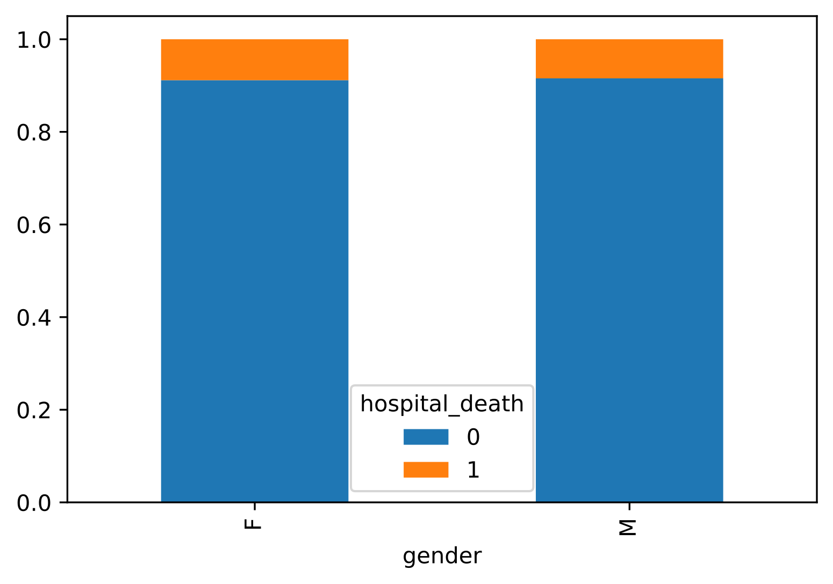
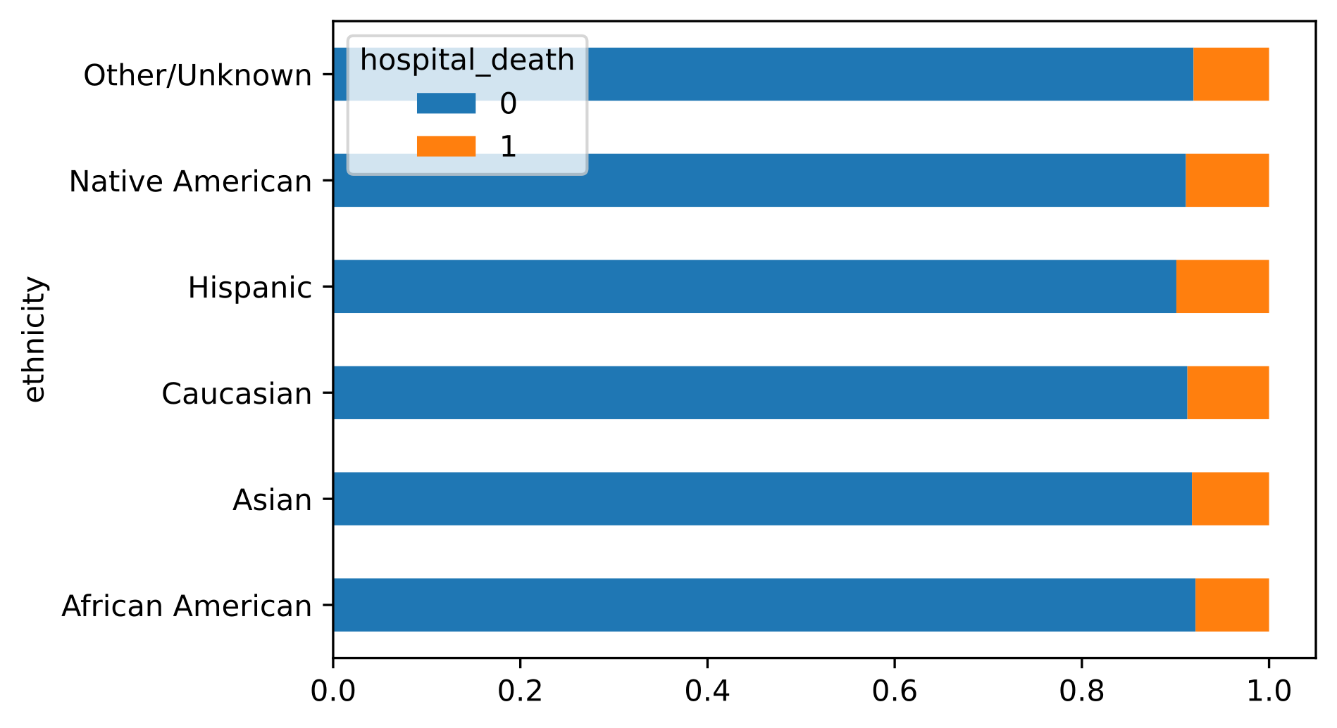
Hospital death:Gender and Ethnicity
Hospital death Is not correlated to the Gender or Ethnicity

Slide 15
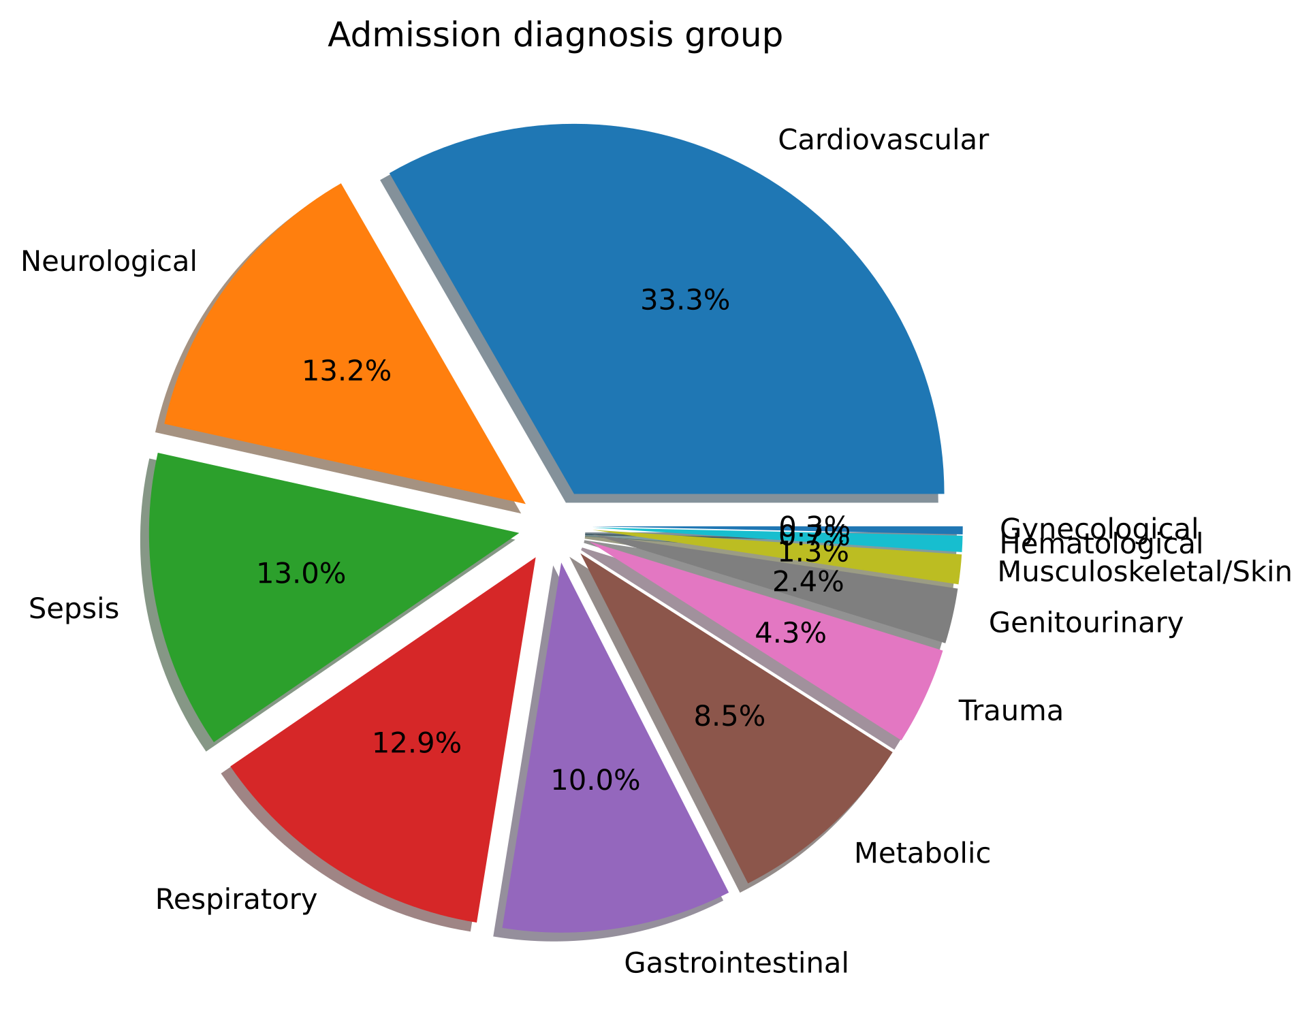
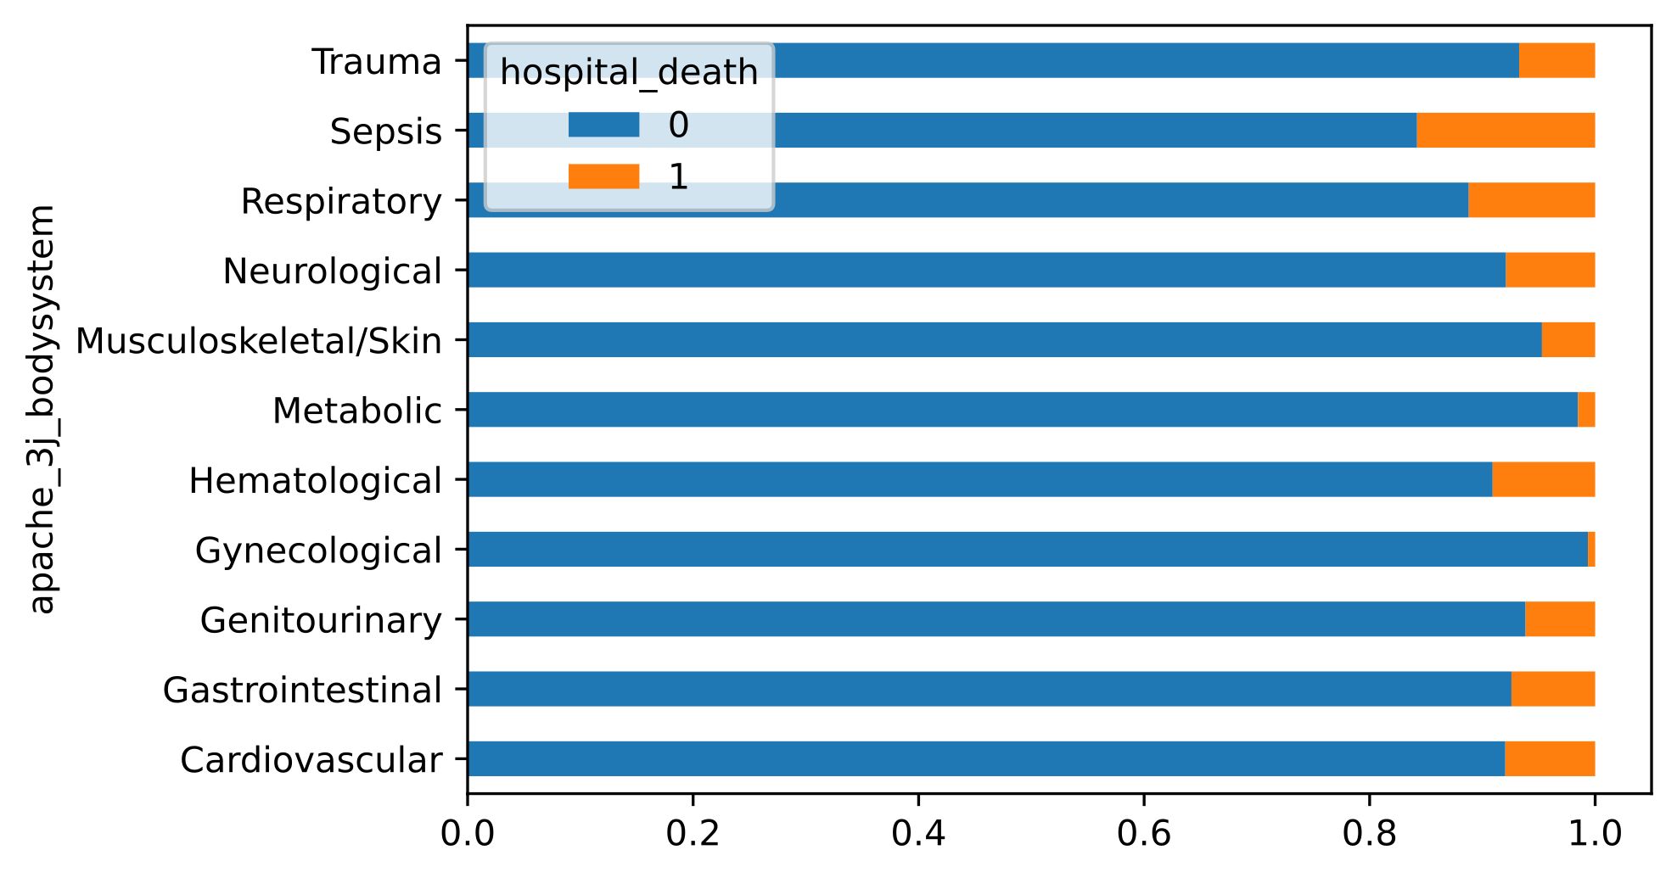
Admission diagnosis and Hospital death
Most frequent Admission diagnosis group : Cardiovascular
The higher death rate: Sepsis

Slide 16
Data Preparation
Remove features with more than 75% missing
Remove collinear features
STD = 0
Data Imputation (KNN and Iterative)
Features Importance ( Random Forest and LightGBM’s)

Slide 17
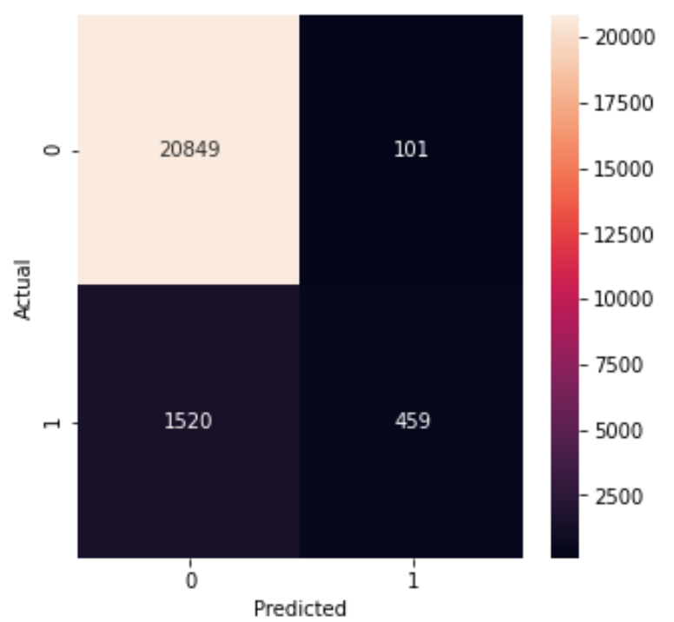
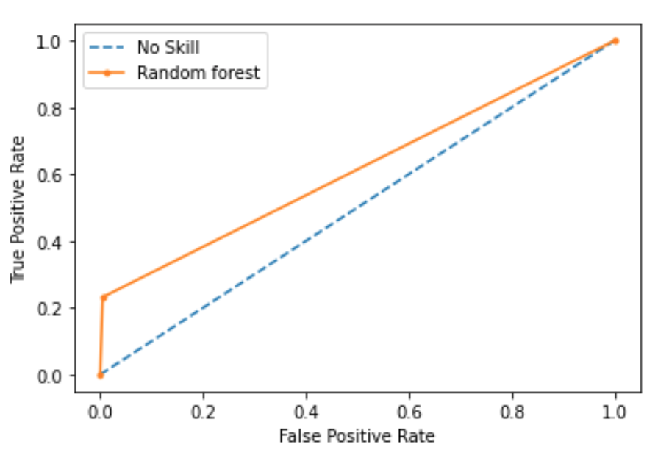
Random Forest: Basic Model
rf_all = RandomForestClassifier(n_estimators= 1000, random_state=42,n_jobs=-1)
Precision: 0.922 / Recall: 0.929 / F1-Score: 0.911 / Accuracy: 0.929
ROC AUC=0.614

Slide 18
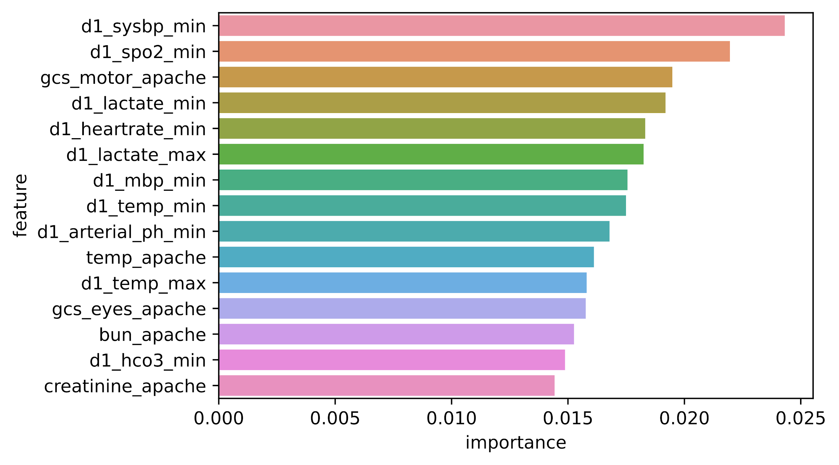
Feature Importances: Numerical Features
importances = list(rf_all.feature_importances_)
The impurity-based feature importance ranks the numerical features to be the most important features.
Lowest systolic blood pressure
Lowest peripheral oxygen saturation
The motor component of the Glasgow Coma Scale
Lowest lactate concentration
Lowest heart rate
Highest lactate concentration
Lowest mean blood pressure
Lowest body temperature
Lowest arterial pH
Temperature resulting in highest APACHE III score
Highest body temperature
The eye opening component of the Glasgow Coma Scale
Blood Urea Concentration resulting in the highest APACHE III score
Lowest bicarbonate concentration

Slide 19
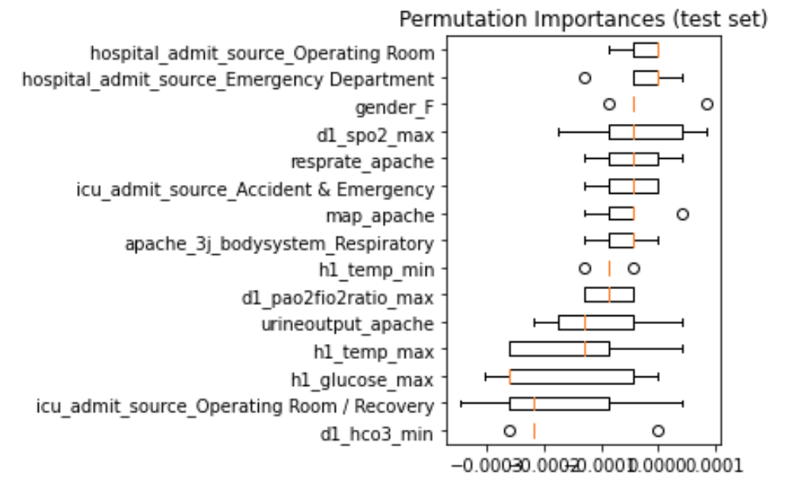
Features Permutation: Categorical Features
Cardinality categorical feature “ Hospital Admit Source Operating Room “ is the most important feature.

Slide 20
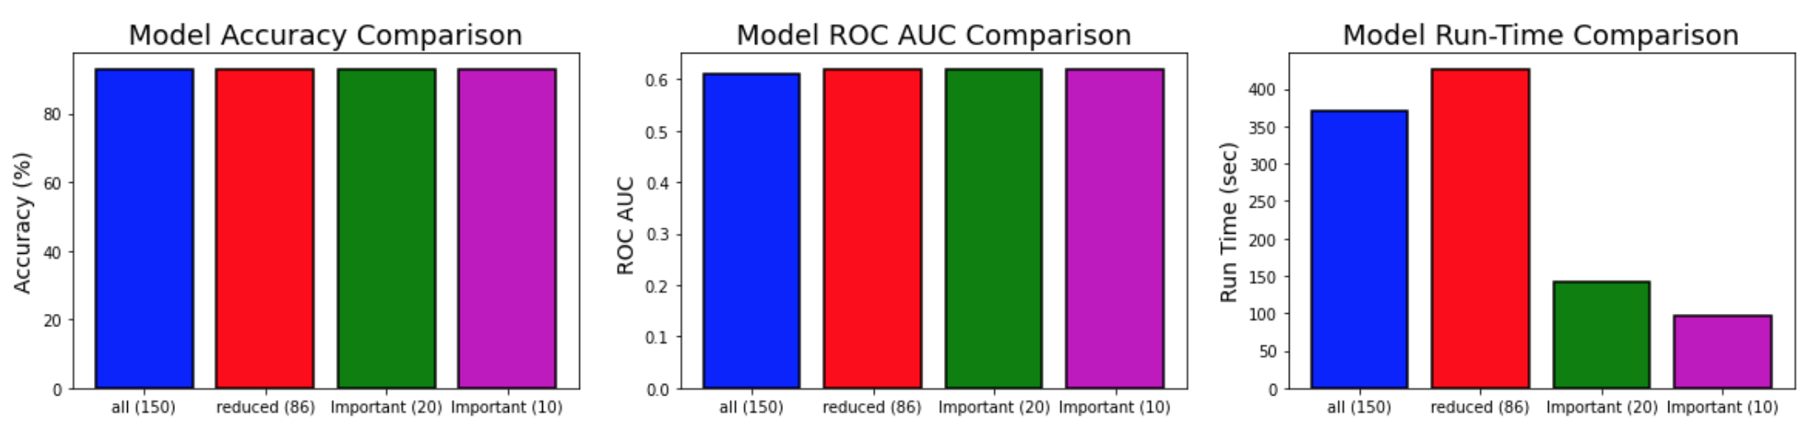
Accuracy vs Run-Time
Number of features for 95% importance: 86/150

Slide 21
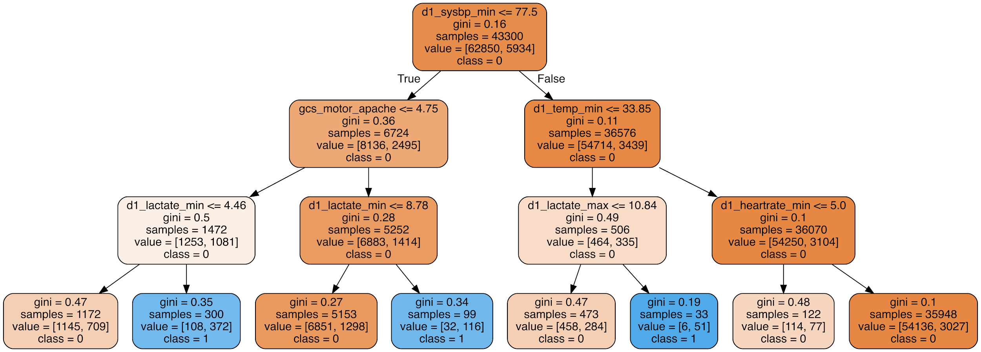
Visualize Tree
rf_small = RandomForestClassifier(n_estimators=10, max_depth = 3)
tree_small = rf_small.estimators_[5]
Lowest systolic blood pressure <=77.5
Glasgow Coma Scale, motor component <=4.75
Lowest temperature <=33.85
Lowest lactate concen-
tration
Lowest heart rate <=5.0

Slide 22
Improving Random Forest:
Random Search with Cross Validation
{'bootstrap': [True, False],
'max_depth': [10, 35, 60, 85, 110, None],
'max_features': ['auto', 'sqrt'],
'min_samples_leaf': [1, 2, 4],
'min_samples_split': [2, 5, 10],
'n_estimators': [200, 400, 600, 800, 1000]}
rf_random.best_params_
{'bootstrap': True,
'max_depth': 85,
'max_features': 'auto',
'min_samples_leaf': 4,
'min_samples_split': 5,
'n_estimators': 1000}

Slide 23
Improving Random Forest:
Grid Search
param_grid = {
'bootstrap': [True],
'max_depth': [90, 100, 120],
'max_features': ['auto'],
'min_samples_leaf': [3, 4, 5],
'min_samples_split': [ 10, 12],
'n_estimators': [1000, 2000]}
grid_search.best_params_
{'bootstrap': True,
'max_depth': 90,
'max_features': 'auto',
'min_samples_leaf': 3,
'min_samples_split': 12,
'n_estimators': 1000}

Slide 24
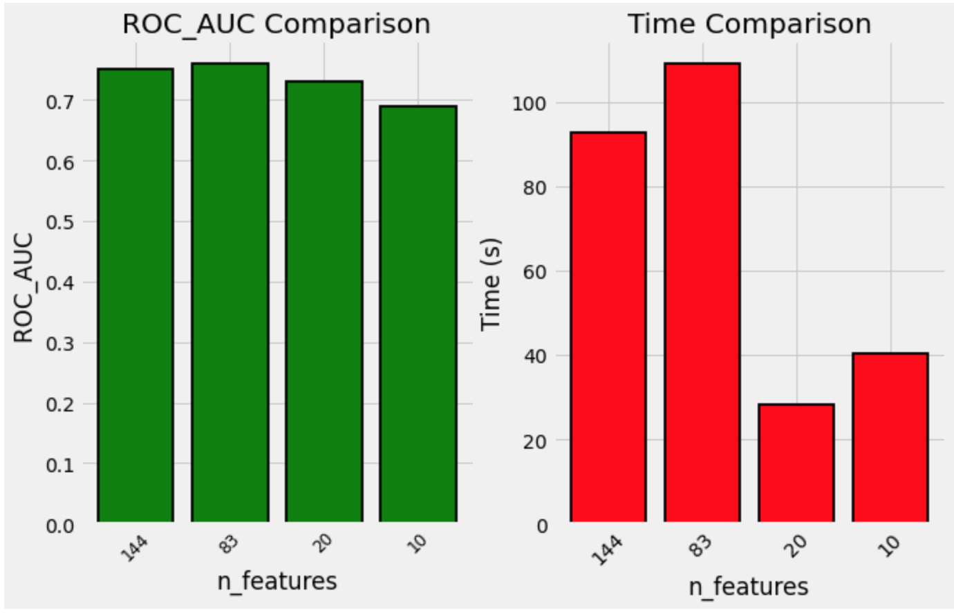
Model Comparison

Slide 25
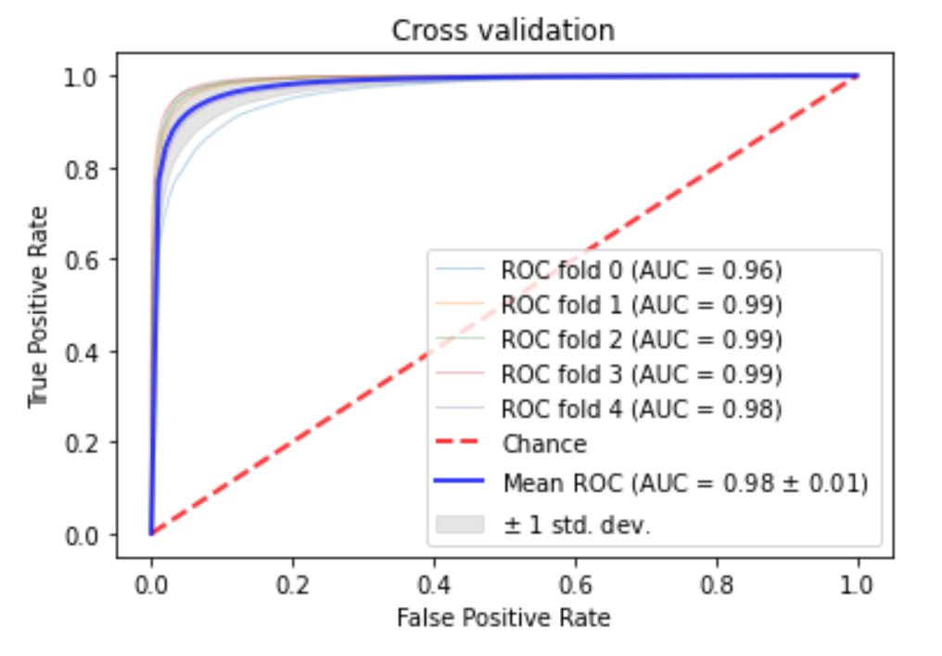

Adaptive Synthetic (ADASYN) method to perform oversampling of the minority class
All Features
10 Most Important Features

Slide 26
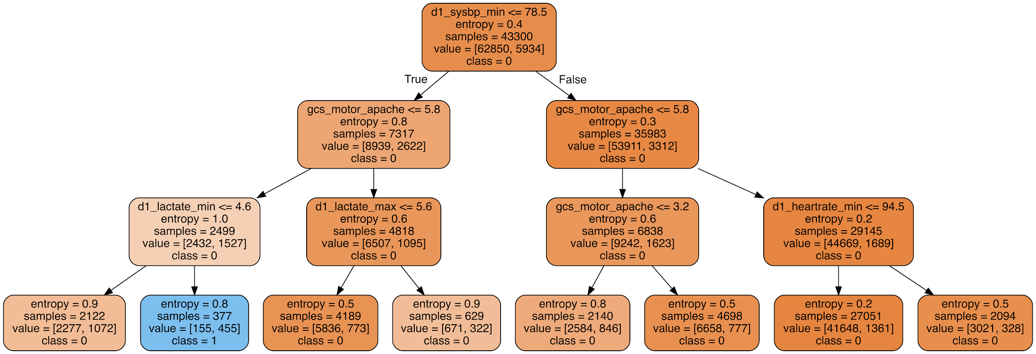
Visualize Tree
max_depth= 3, max_features= 'auto', n_estimators= 10, criterion = 'entropy',
Lowest systolic blood pressure <= 78.5
Glasgow Coma Scale, motor component <=5.8
Lowest lactate <=4.6
Patient with high risk?
Notes:
Low sys bp
Low gcs
li lactate

Slide 27
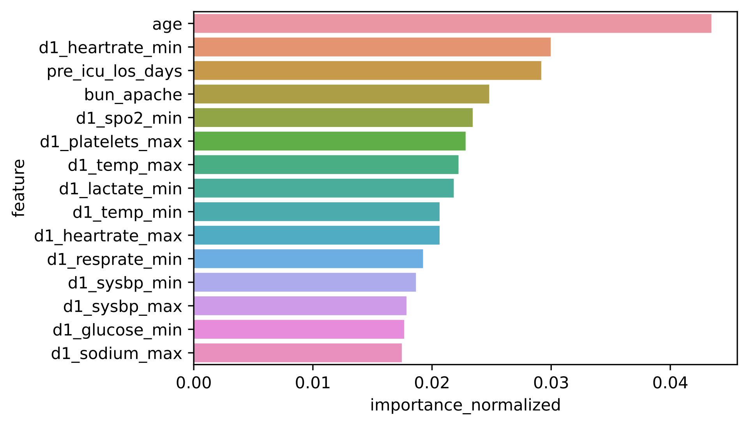
Light Gradient boosting machine (GBM) learning model
Most Important features are different than those found by Random forest
Age
Lowest heart rate
Length of hospital stay before ICU admission
Blood urea concentration resulting in highest APACHE III score
Highest platelet count
Highest body temperature
Lowest lactate concentration
Lowest body temperature
Highest heart rate
Lowest respiration rate
Lowest systolic blood pressure
Highest systolic blood pressure
Lowest glucose concentration
Highest sodium concentration

Slide 28
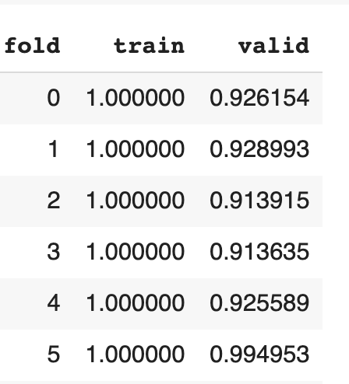
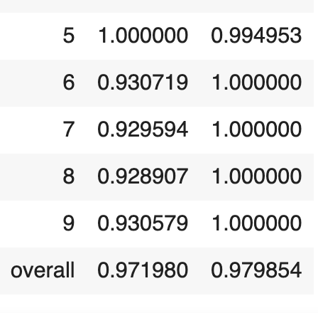
Gridsearch, Train, and Validation
best_params_
{'learning_rate': 0.01,
'n_estimators': 10000,
'num_leaves': 127,
'reg_alpha': 0.1}
Best_score_(metric='auc’)
AUC: 0.93

Slide 29
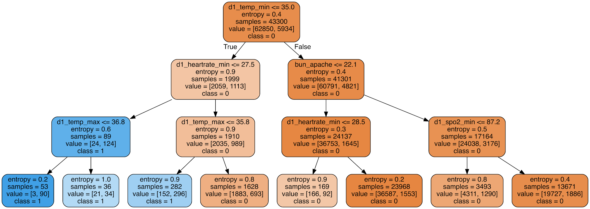
Random Forest tree with the 10 most important LightGBM Features
Lowest body temperature <=35.0
Lowest heart rate
<=27.5bpm
Lowest blood urea nitrogen concentration <=22.1
Highest body temperature <=36.8
Lowest peripheral blood oxygen saturation <=87.2
Patient with high risk?

Slide 30
kaggle competitions Score
Winner : 0.91497
LightGBM: 0.88001 (leaderboard : 756)
Random forest: 0.66983

Slide 31
Dataset 2:
Understanding Suicide Causes

Slide 32
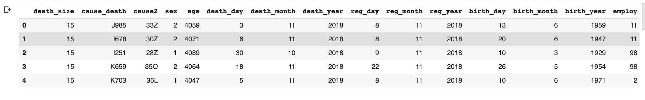
Cause of Death dataset from Mexico (provided by CAMH)
Demographic Data
722611 entries and 49 attributes.
Collected in Mexico ( 1935 -2018)
Catalog ICD10 (International Statistical Classification of Diseases and Related Health Problems).
No Label
ICD10

Slide 33
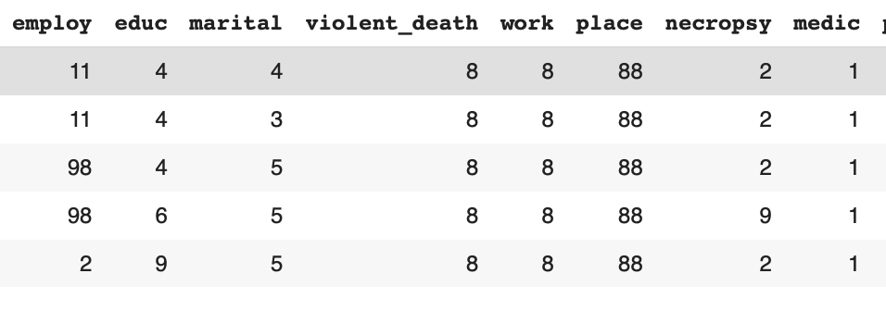
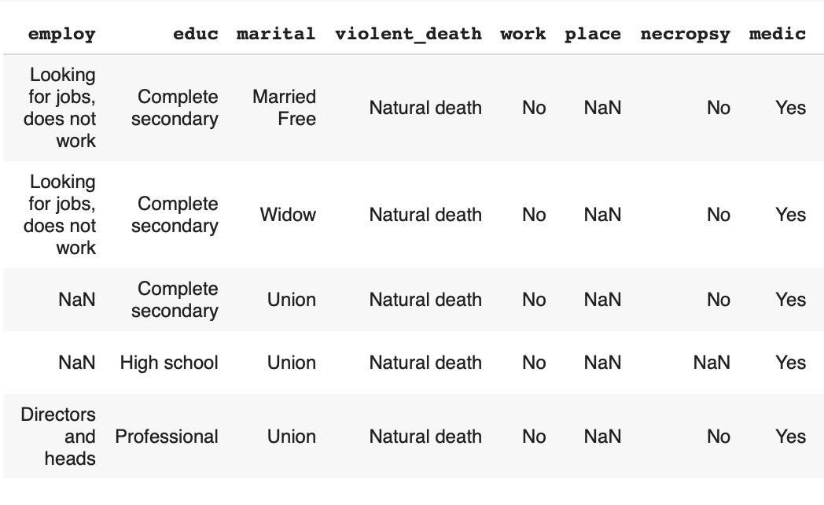
Pre-processing
Original data is coded, making it very difficult to interpret.
Coded
Decoded
Decoding data to make it readable by humans is essential.

Slide 34
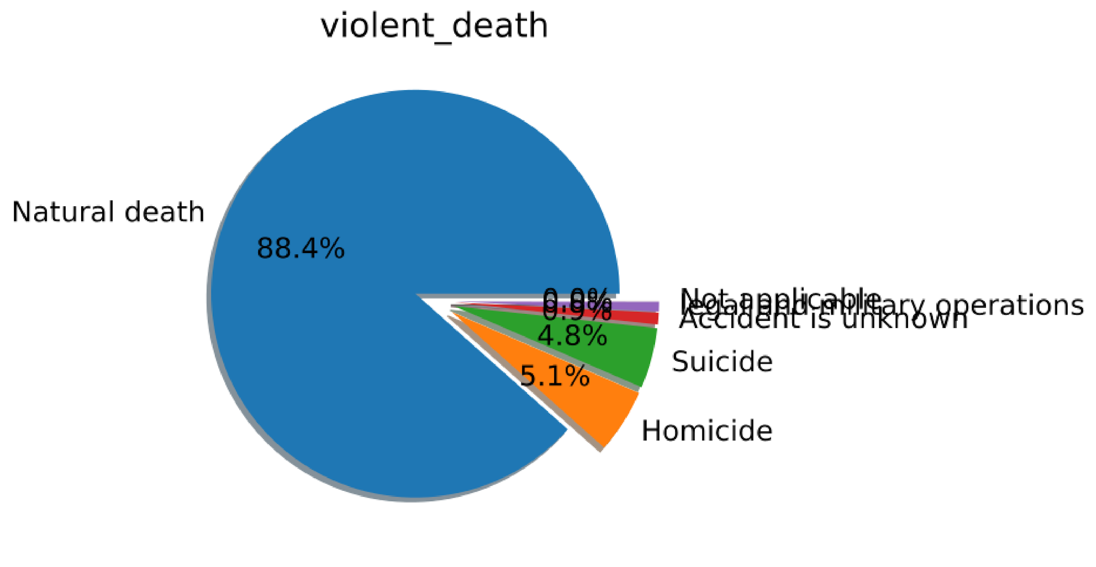
Create the Target
Data Are Unbalanced

Slide 35
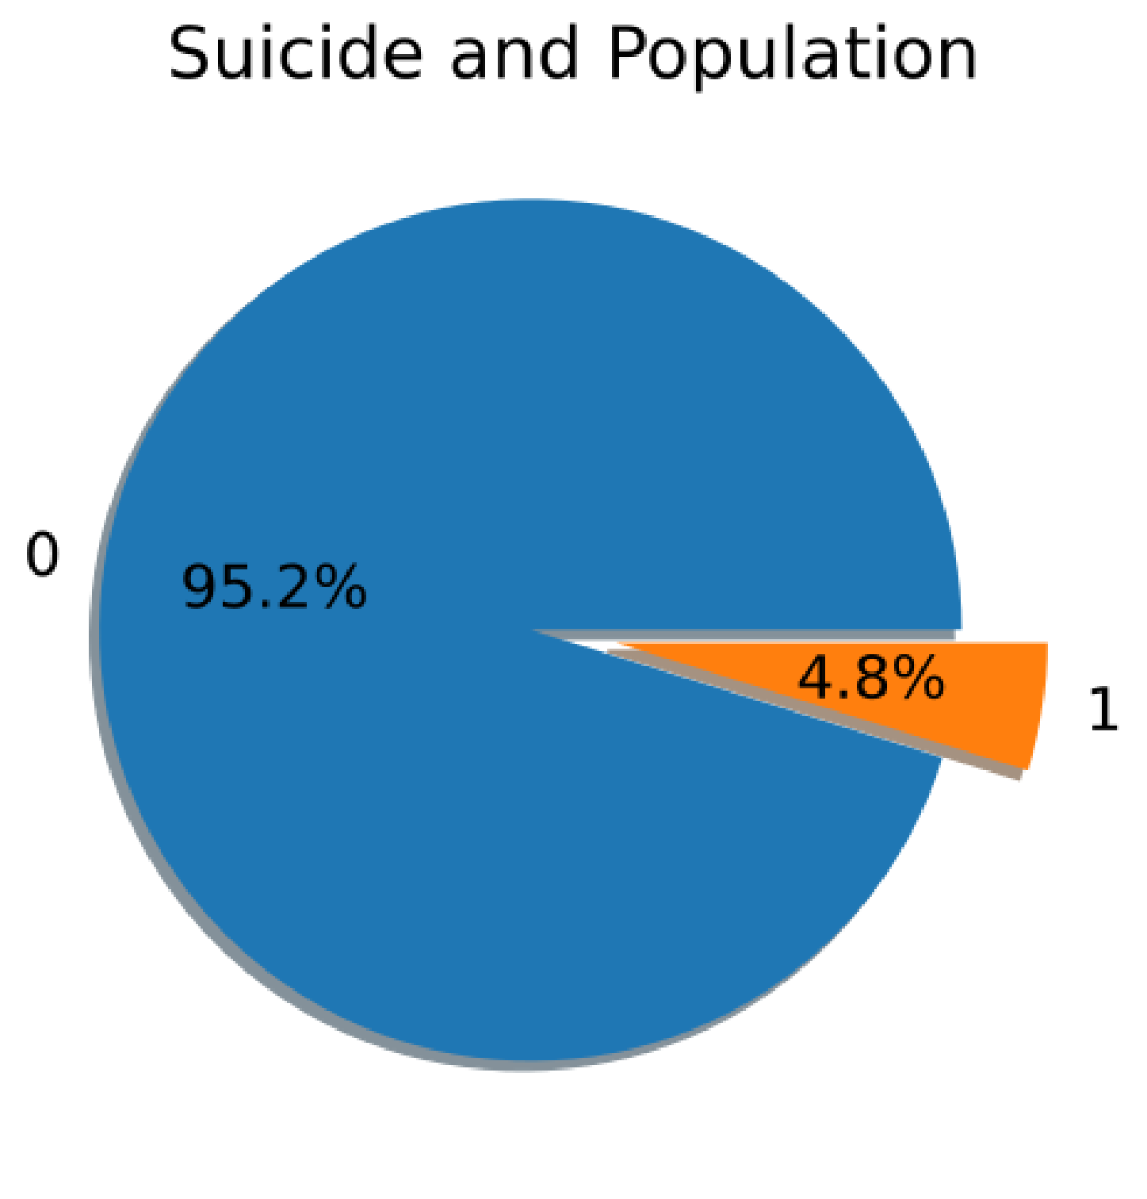
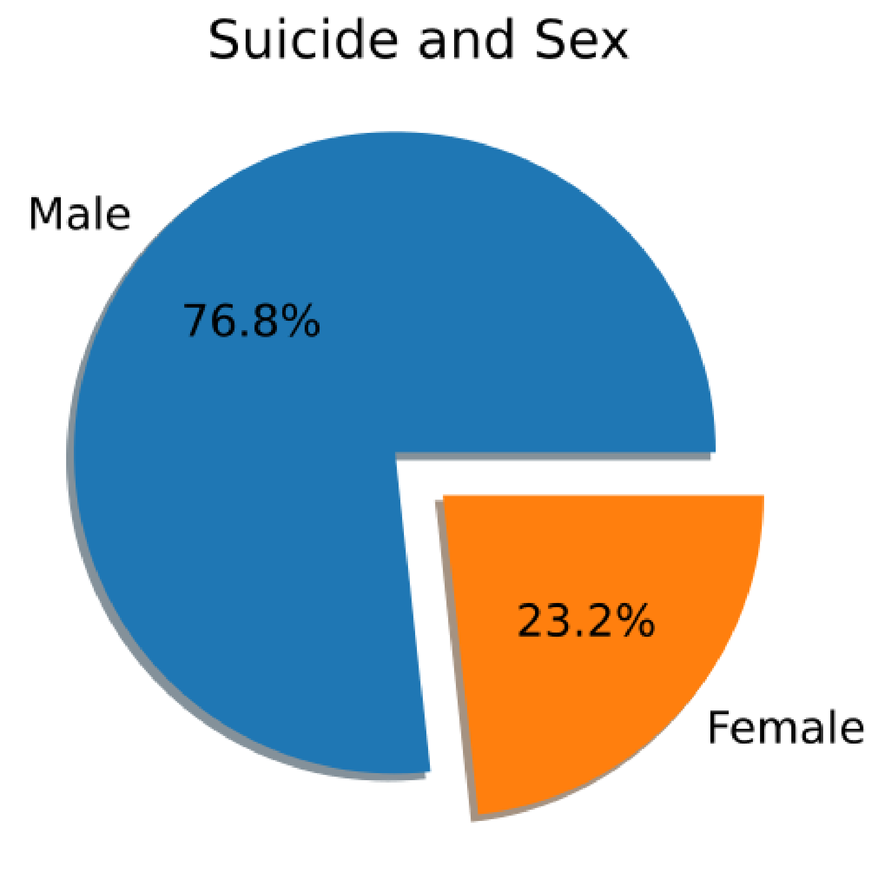
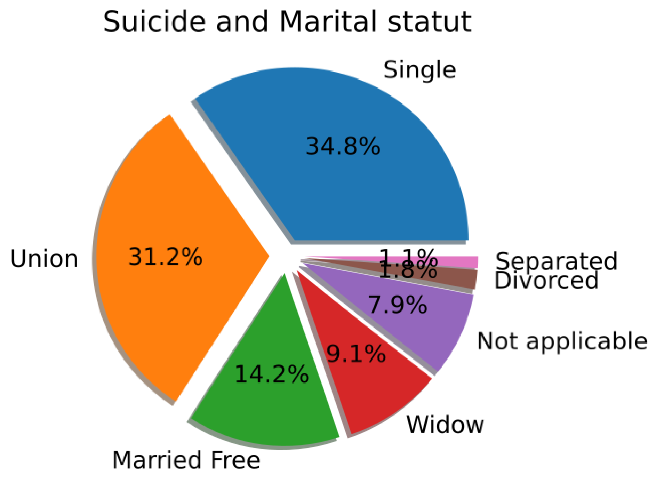
Suicide: Population, Sex and Marital status

Slide 36
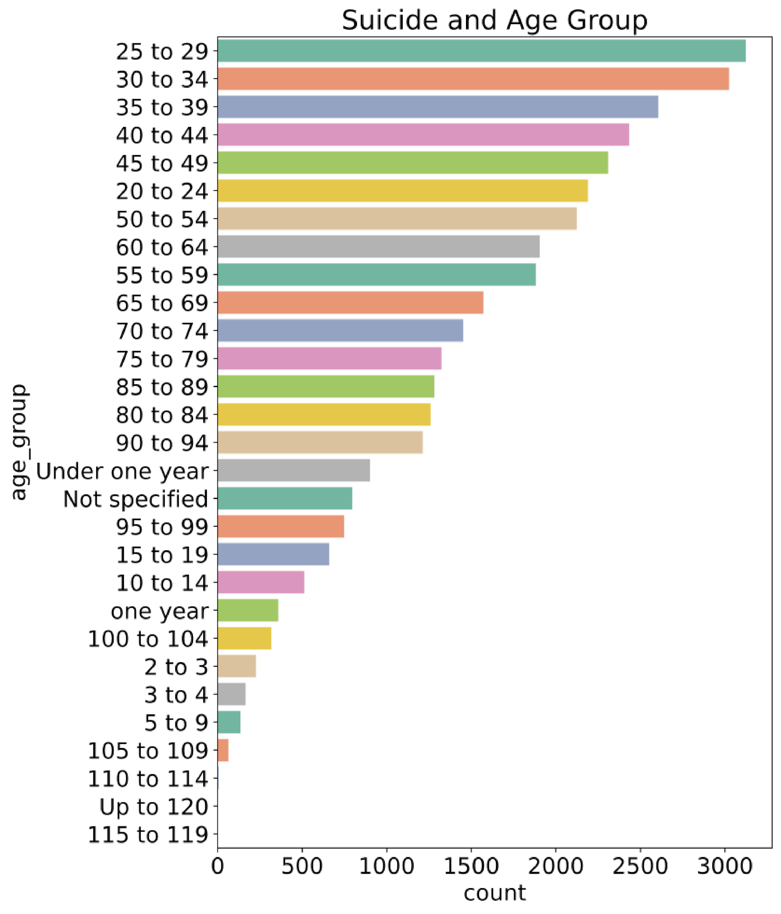
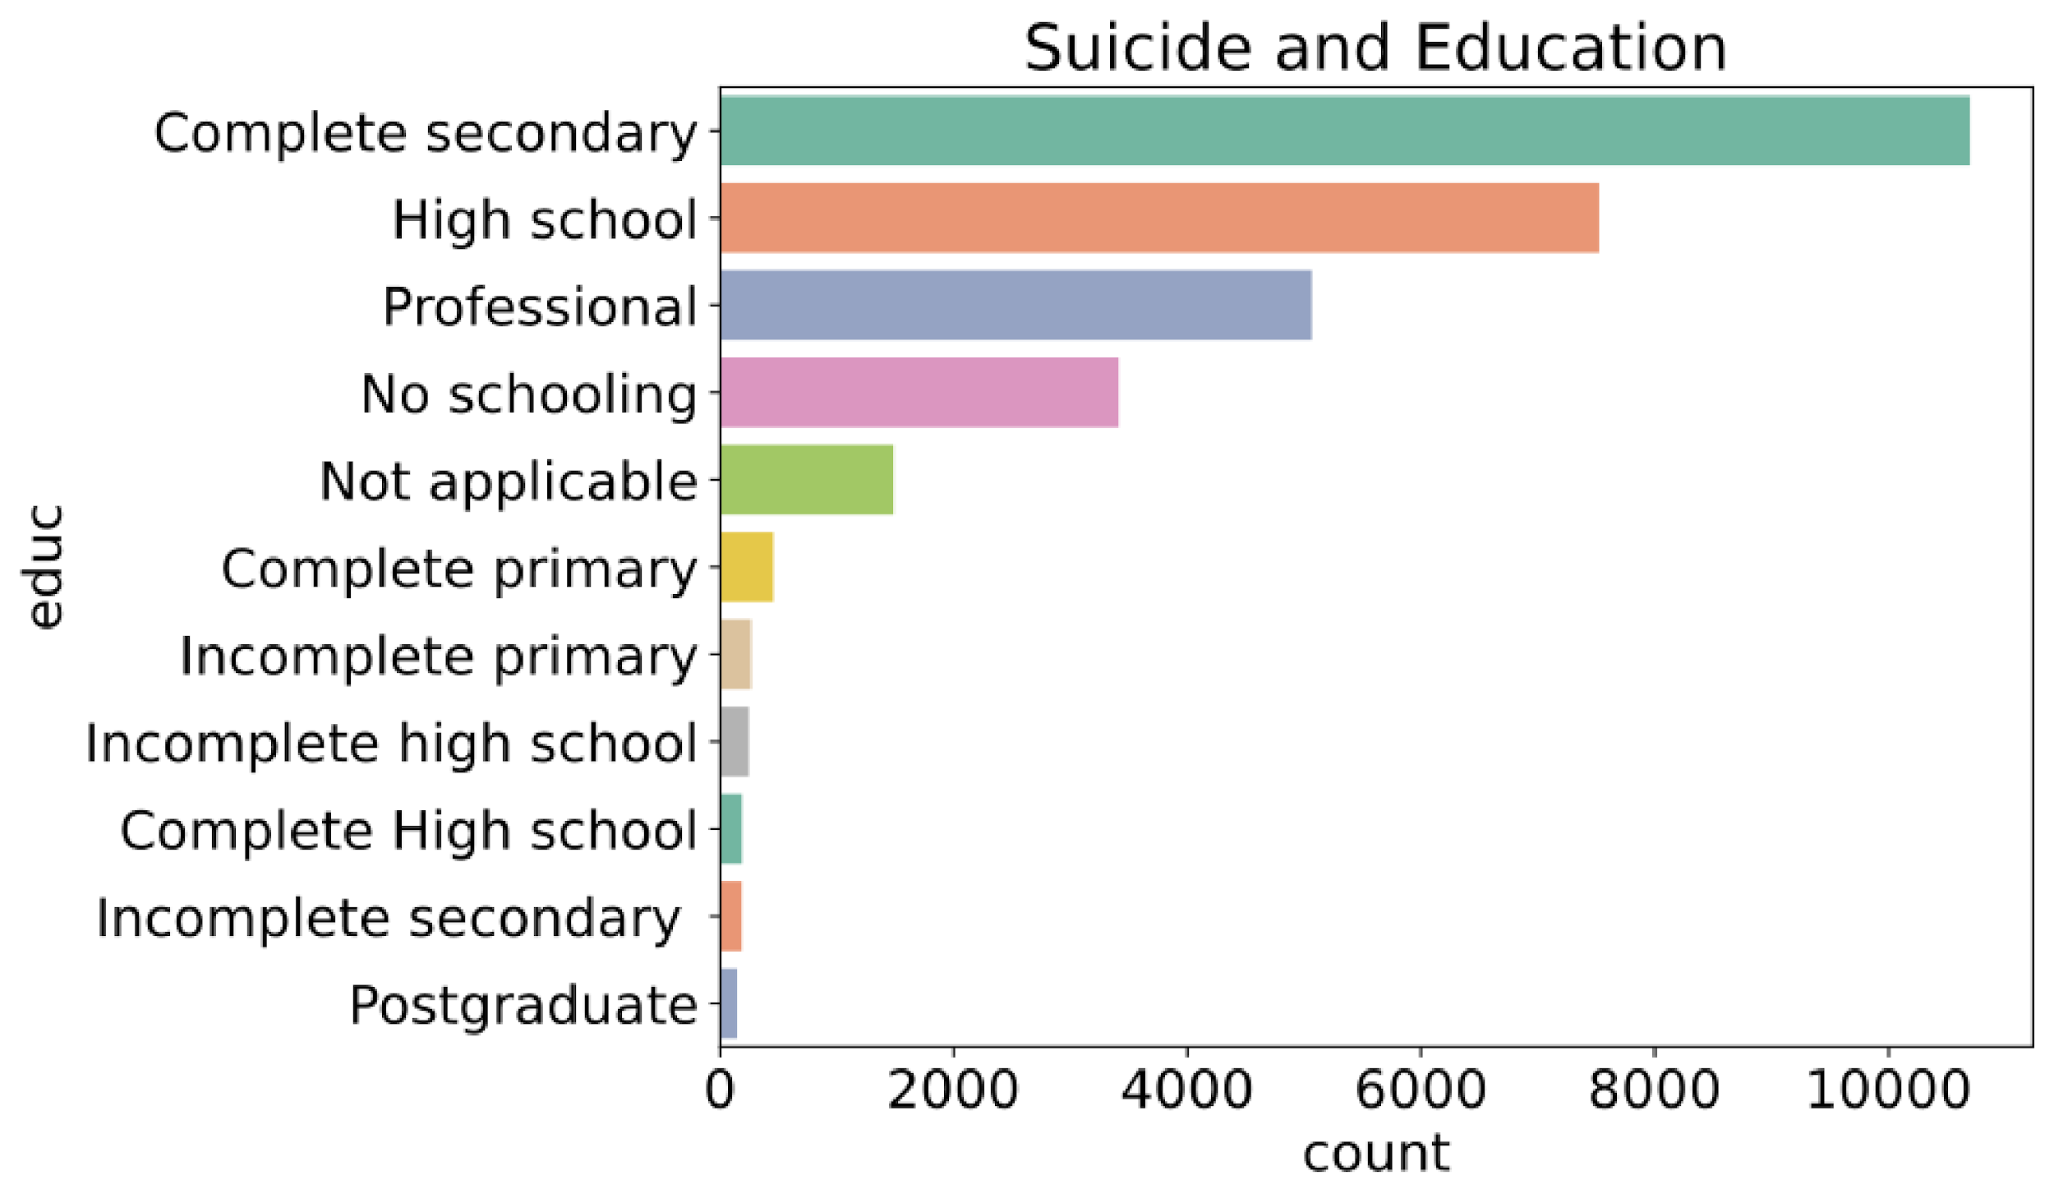
Suicide: Education and Age

Slide 37
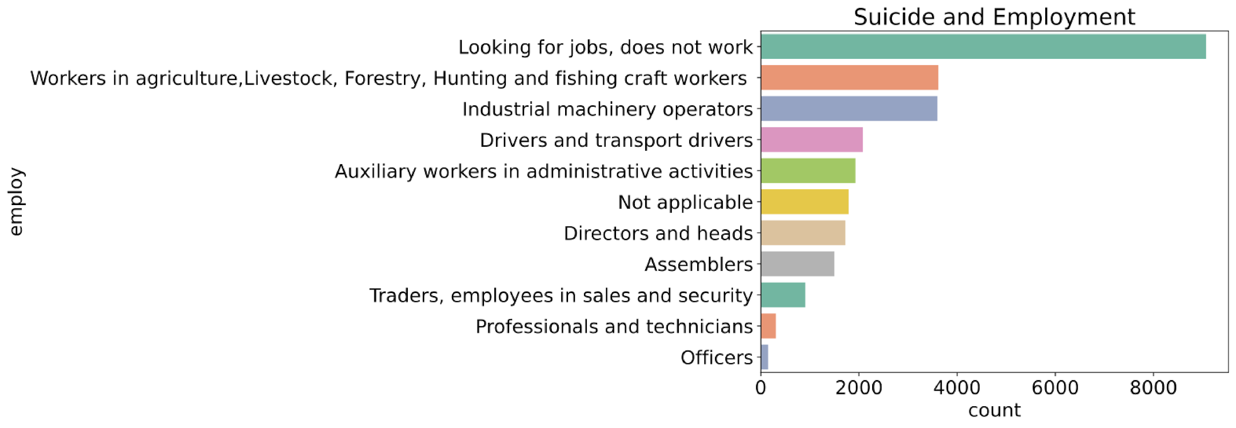
Suicide: Employment

Slide 38
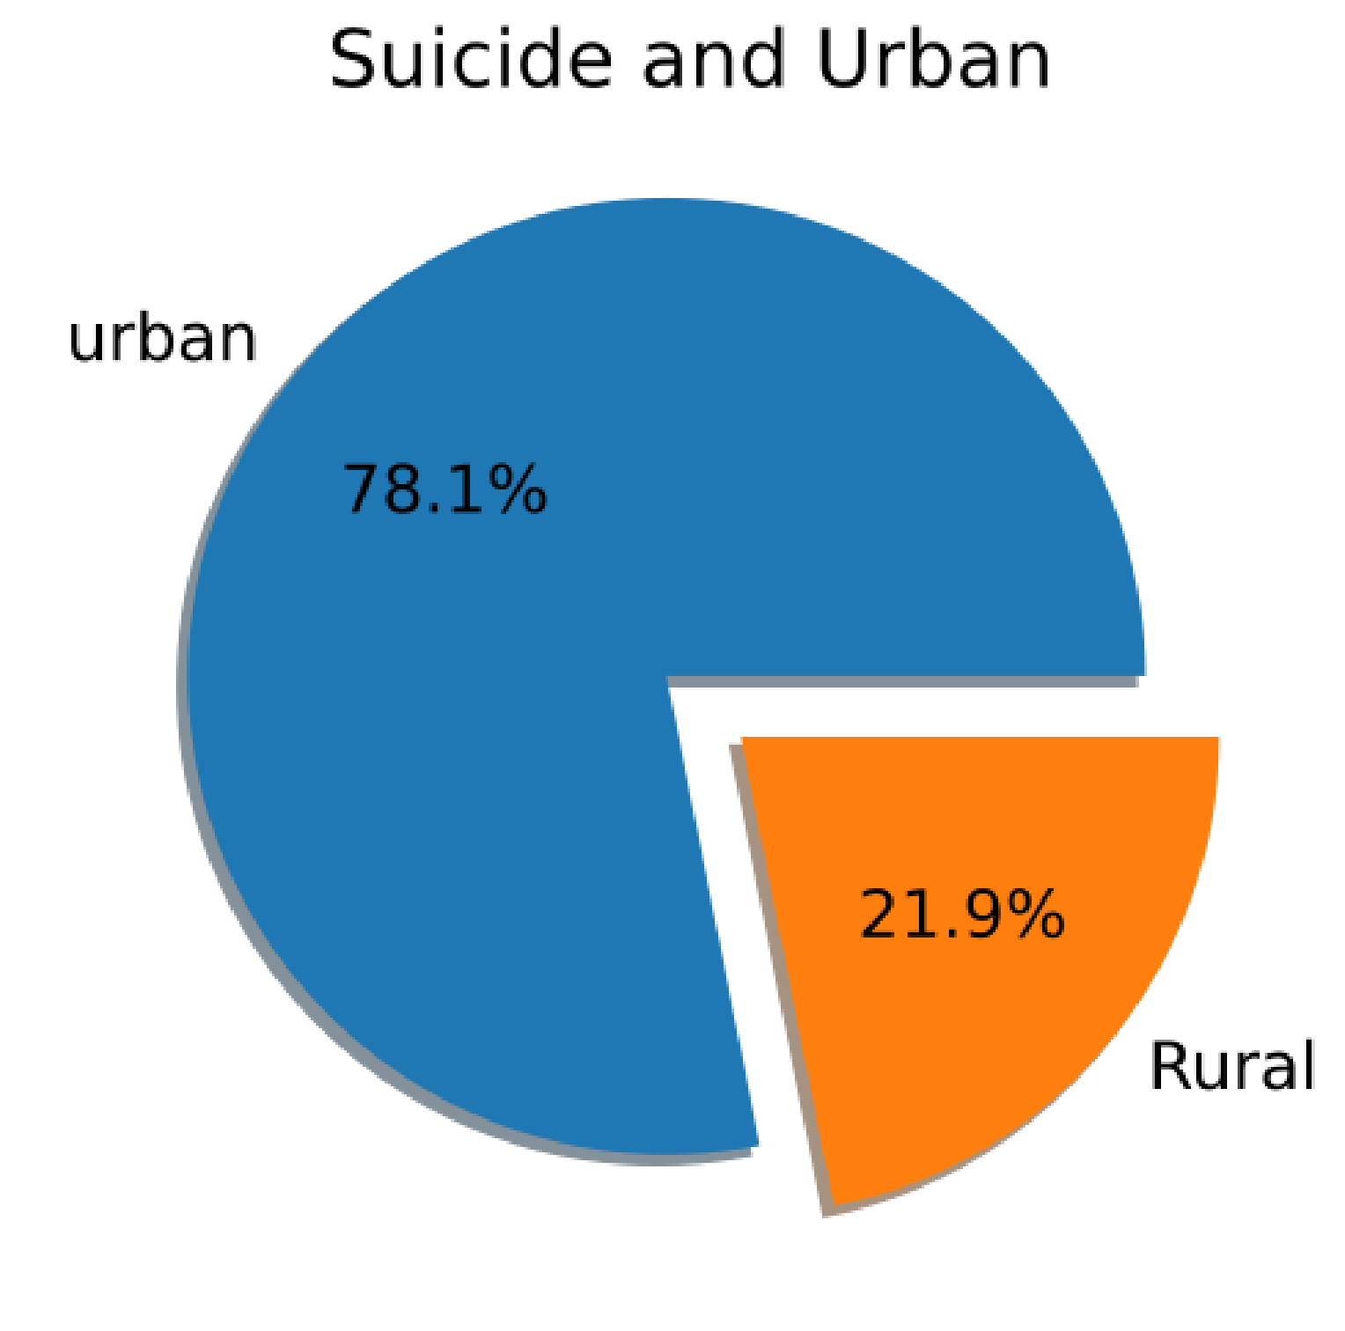
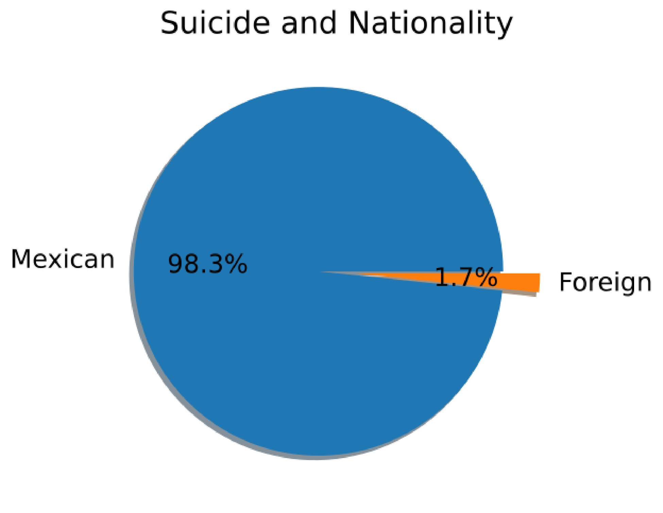
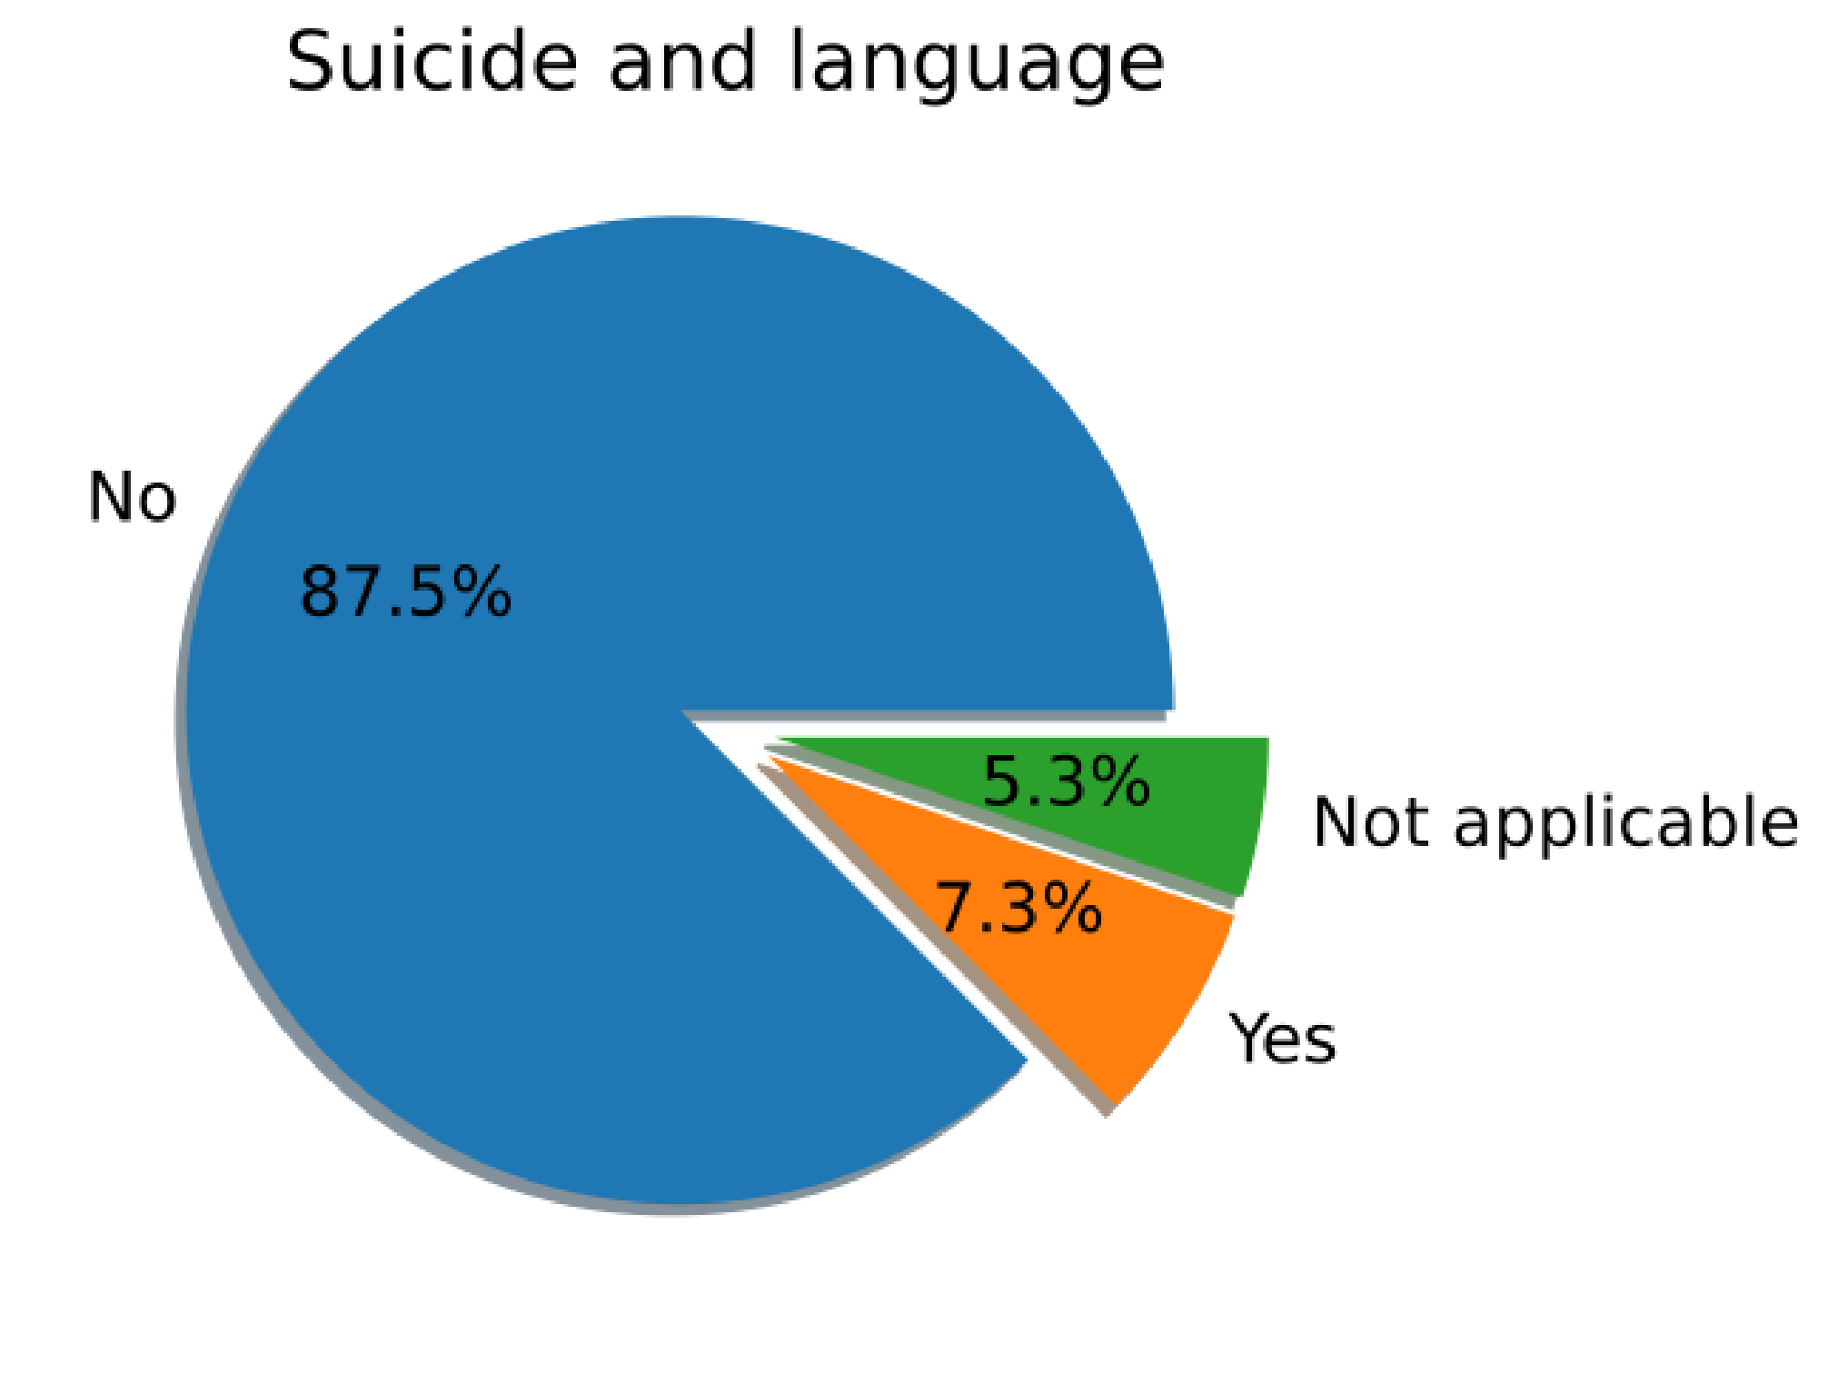
Suicide: Urban and Nationally, Indigenous

Slide 39
Pre-processing and split into train and test
Remove features with more than 75% missing
Remove collinear features
STD = 0
Data Imputation (KNN and Iterative)
Split data into train (40%) and test (60%)

Slide 40
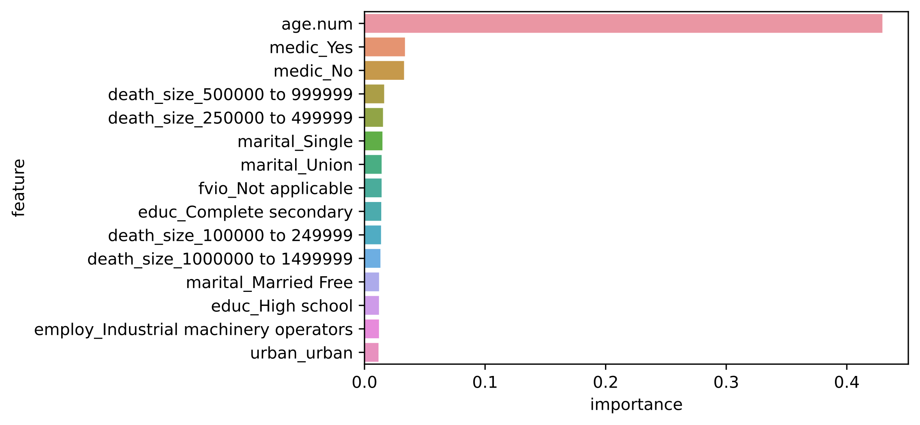
Features Importance: Random Forest
Age
On medication
Population size in the city
Marital status - Single/not-single
Violence in the family
Education level
Industrial machinery operators
Urban

Slide 41
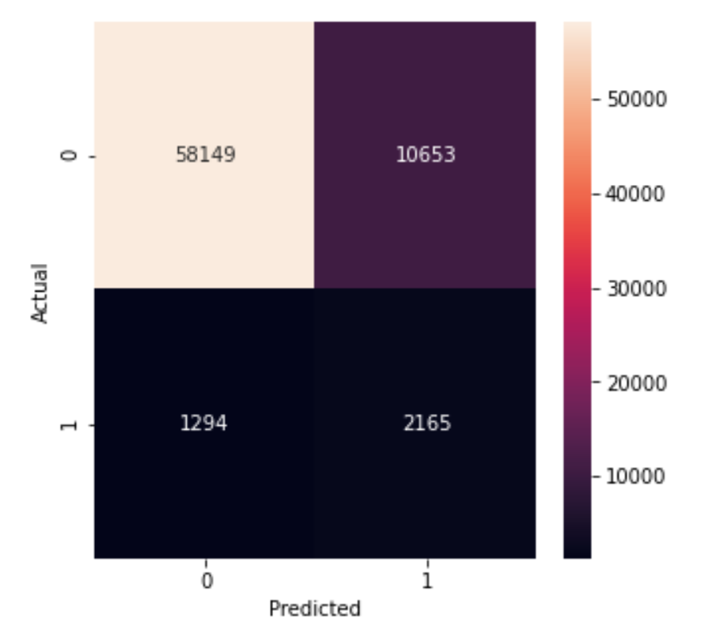
Decision Tree Model:
Grid Search and Cross validation
Grid_cv.best_params_
{'class__criterion': 'gini',
'class__max_depth': 20,
'class__max_features': 'auto',
'class__max_leaf_nodes': 100,
'class__min_samples_split': 2}

Slide 42
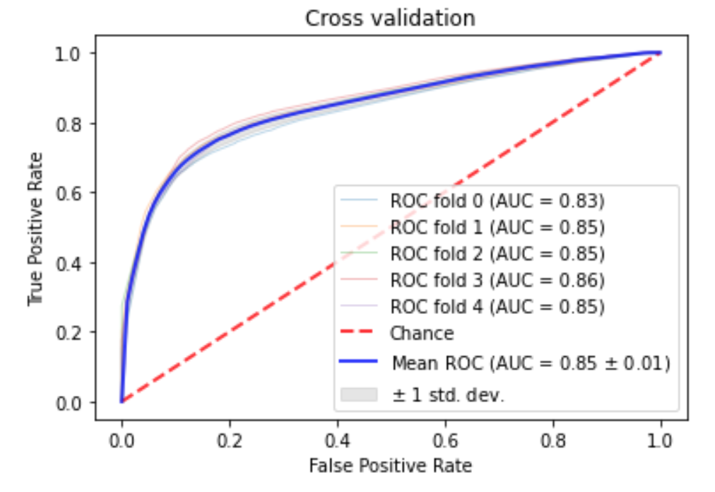
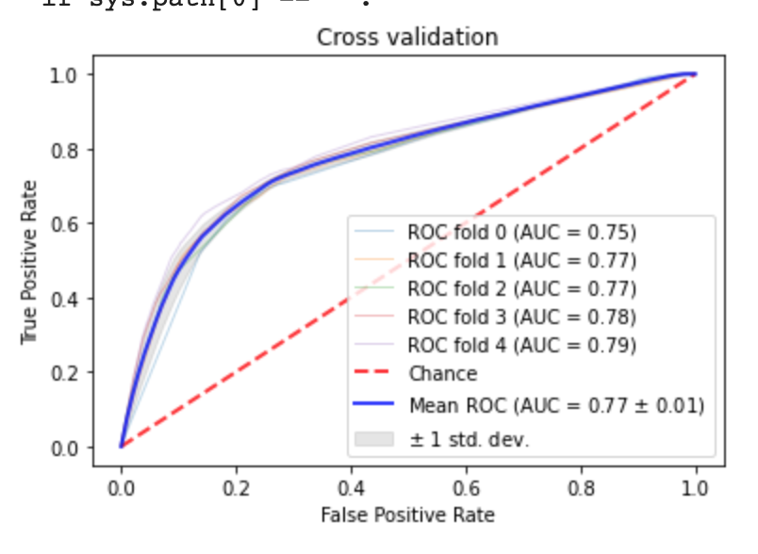
Decision Tree: Best model
51 most Important Features (95%)
10 most Important Features

Slide 43
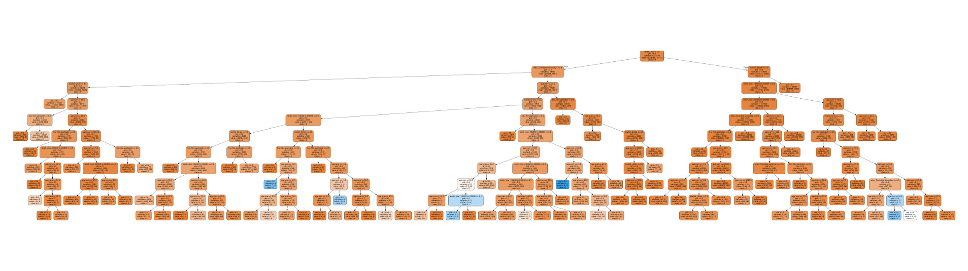
Visualize Tree—Overview
max_depth= 10, max_features= 'auto', n_estimators= 10, criterion = 'gini',

Slide 44
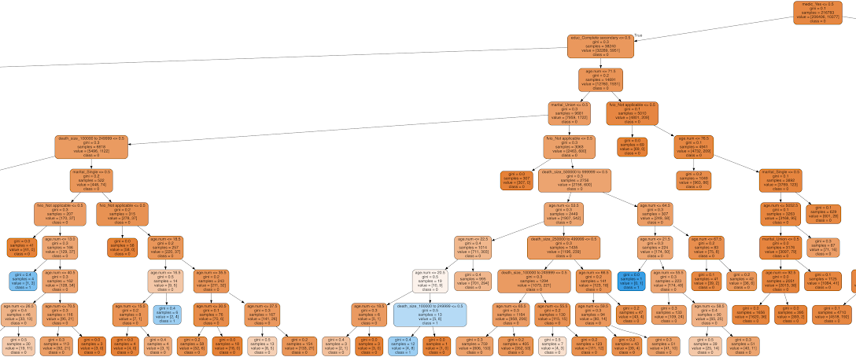
Visualize Tree (10 most important features)
On medication
max_depth= 10, max_features= 'auto', n_estimators= 10, criterion = 'gini',
Completed secondary education
Age <=71.5
Married
Violence in the family
100K-200K (city size)
Violence in the family
Single
.5M-1M
Violence in family
Age <=53.5
Age <=64.5
Age <=13.0
Age <=18.5
Age <=22.5
Age <=21.5
Age <=16.5
Age <=20.5
100K-250K
Person with high risk?
Notes:
1 in 5 deaths - Suicide

Slide 45
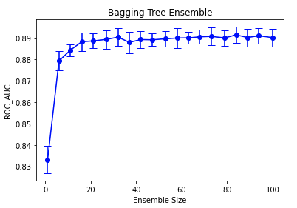
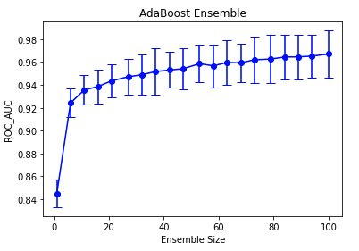
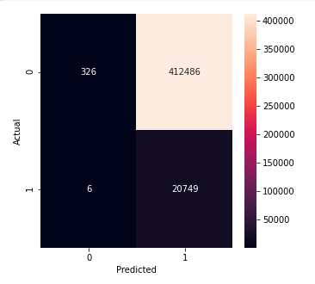
Ensemble method
Auc : 0.85 (+/- 0.00) [Decision Tree]
Auc : 0.89 (+/- 0.00) [Bagging]
Auc : 0.97 (+/- 0.02) [boosting]
Confusion matrix, Adaboost, predicting on test data

Slide 46
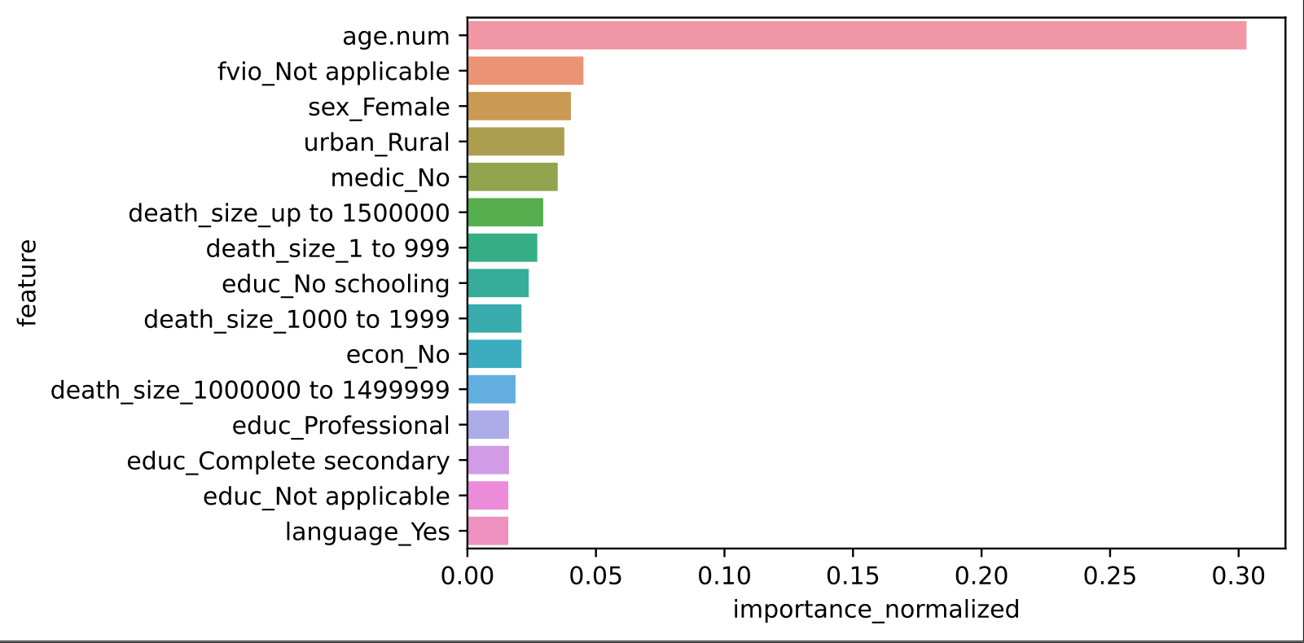
Light Gradient boosting machine (GBM) learning model
Age
Family Violence
Gender - Female
Urban/Rural Area
Not on medication
Size of the city
No schooling
Unemployed
Speaks indigenous language

Slide 47
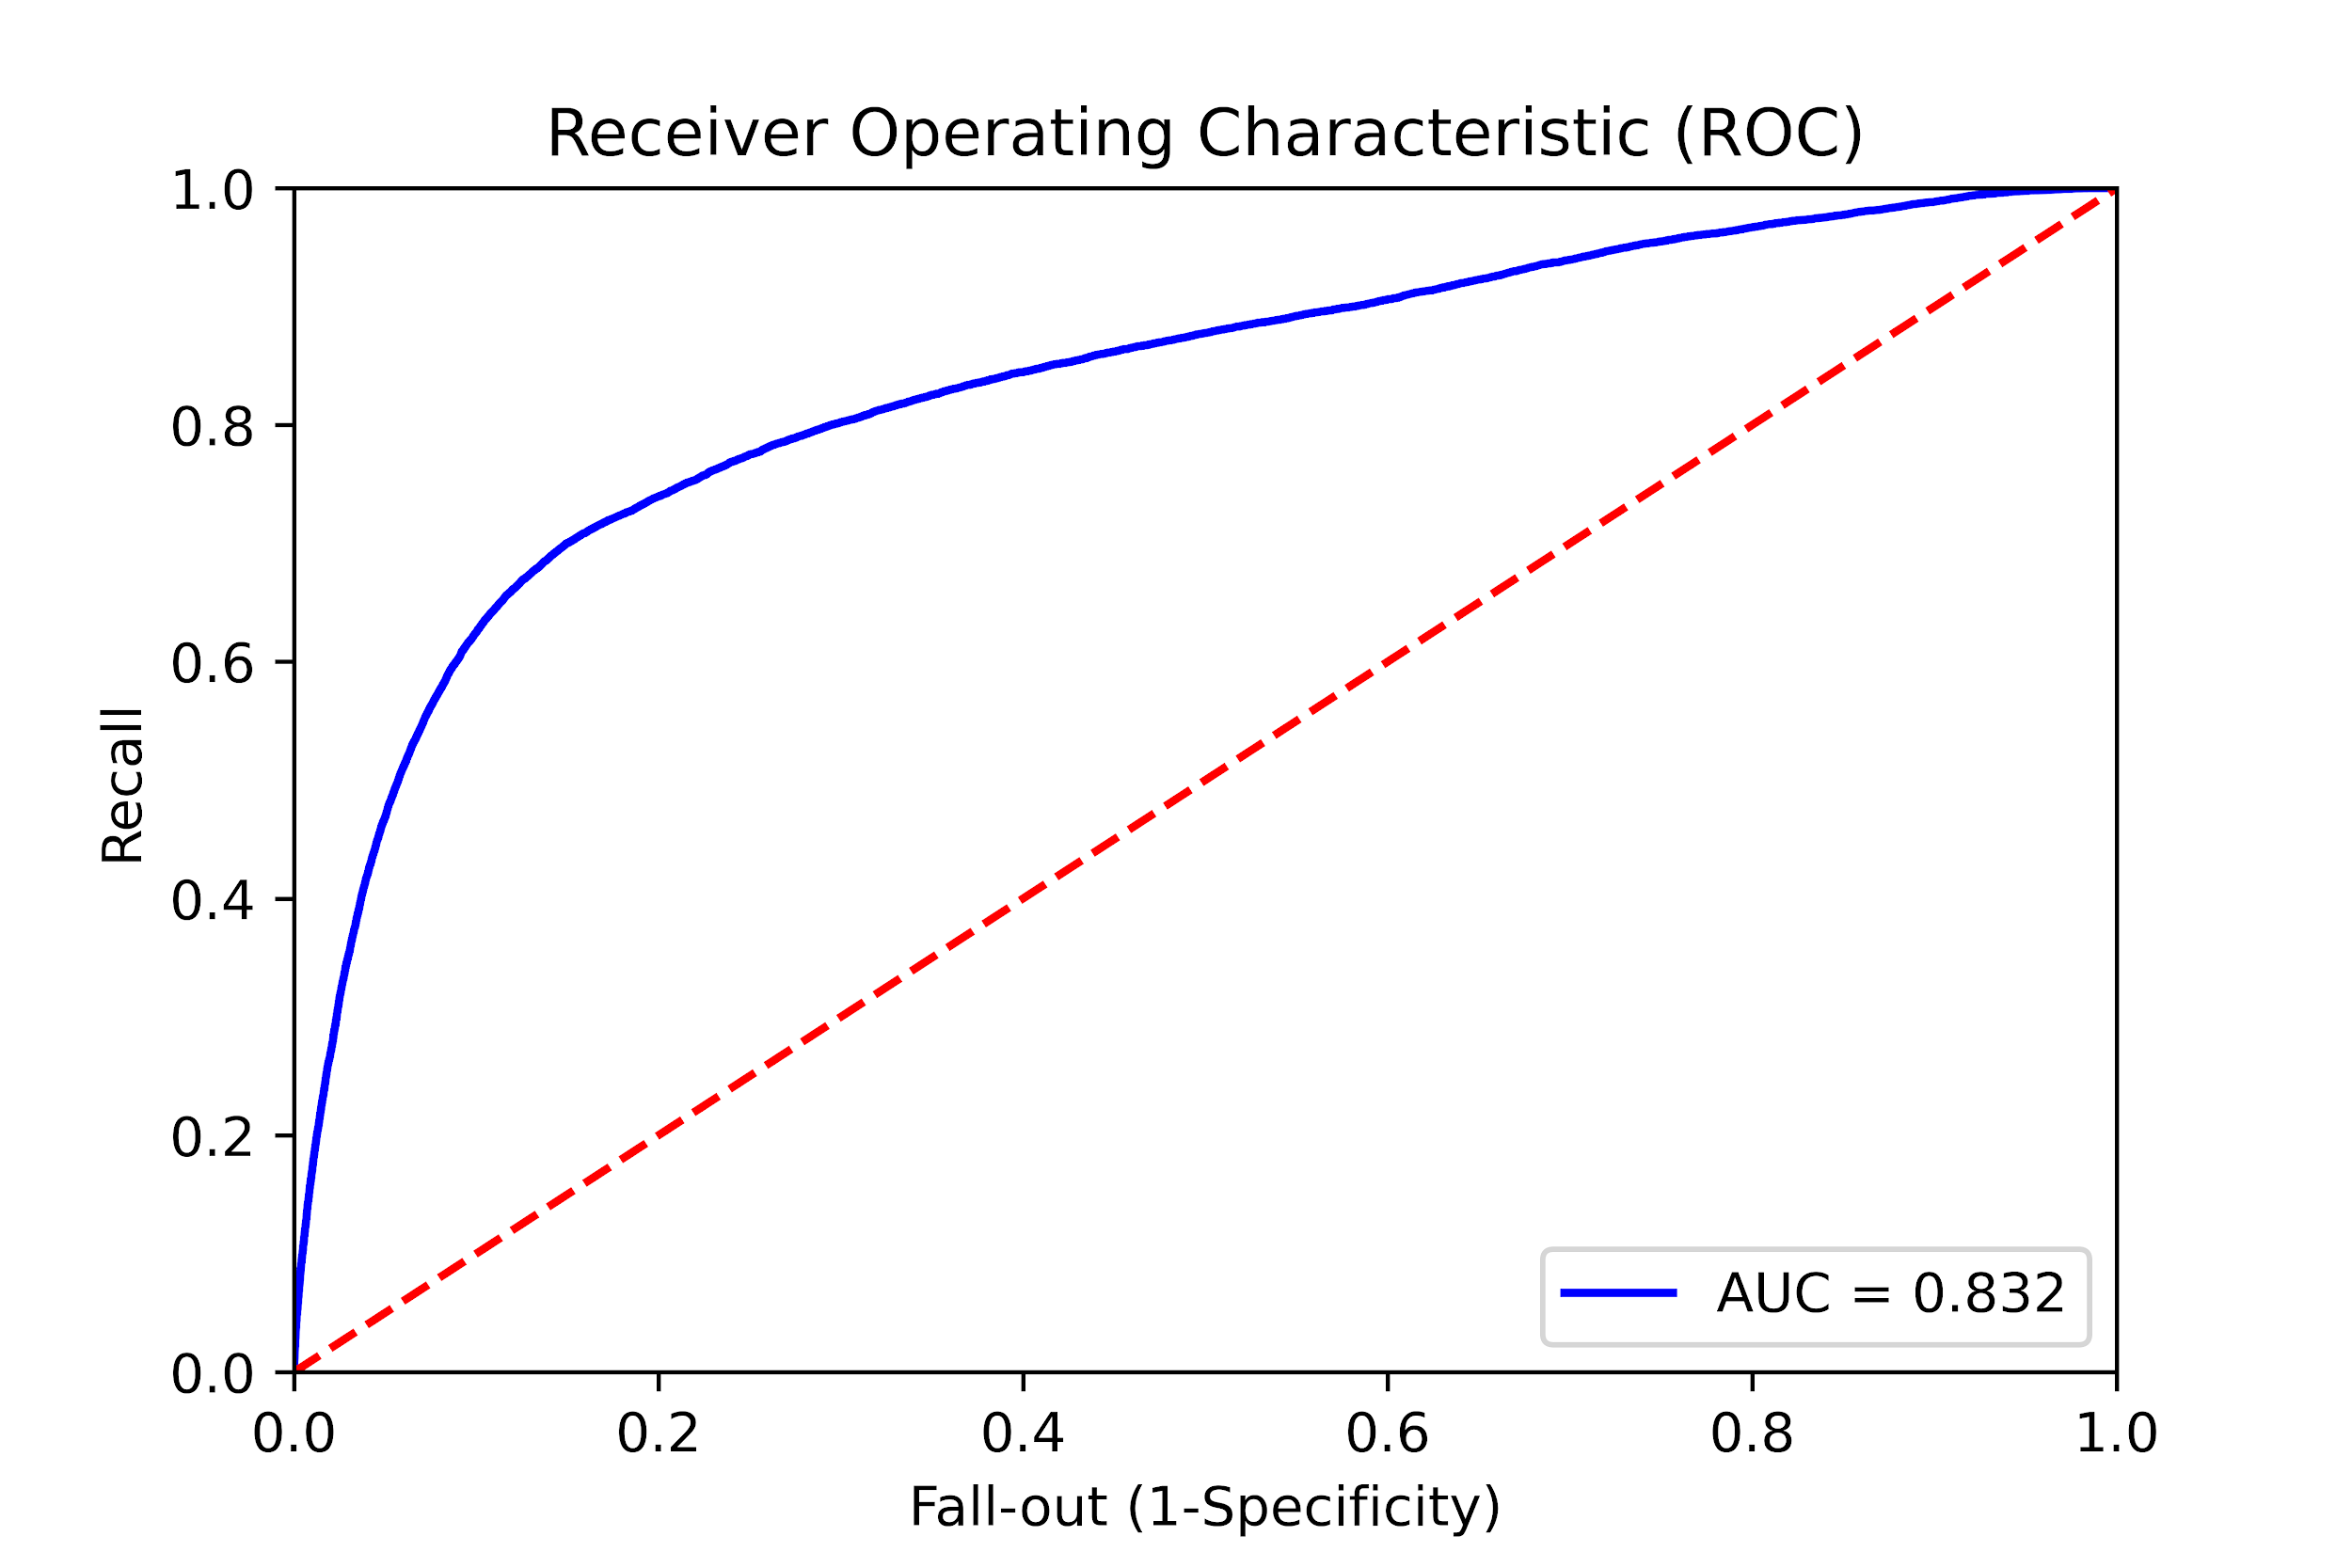

Light Gradient boosting machine (GBM) learning model
Grid Search , train and evaluation ( with train data)
Prediction on test data

Slide 48
Conclusions—Emergency Room Mortality Risk
The most important features for predicting Emergency Room mortality risk are
Lowest systolic blood pressure
The motor component of the Glasgow Coma scale (GCS - Eye, Verbal and Motor responses)
Lowest body temperature
Lowest lactate concentration
Lowest peripheral blood oxygen saturation
Blood Urea Concentration resulting in the highest APACHE III score
Length of hospital stay before ICU admission

Slide 49
Conclusions—Suicide Risk
The most important features for predicting suicide risk are
On medication
Completed secondary education
Age
Marital status
Violence in the family
City size
The highest risk sequence of features appears to be: On medication, not finished secondary education, not married, and between the ages of 20.5 and 22.5.

Slide 50
Recommendations
Compare features identified as important with current data collection policies and procedures
Identify any important data features that are not currently being collected consistently and accurately
Assess possibility of collecting these features with more rigour
Recommend changes to data collection policies and procedures that ensure thorough and accurate collection of important information

Slide 51
Future Work
Improve results further—Include more types of models in ensemble
Use results to inform optimization of data collection, both clinical and demographic
Build machine learning applications to help medical professionals assess patient mortality risk and suicide risk in real-time
Integrate inferences in the current CAMH dashboard

Slide 52
Thank You
Team 2: Pete Gray, Pratik Chandwani, Conrard Giresse Tetsassi Feugmo
York University CSML 1030

Slide 53
Improving Healthcare: Hospital Emergency
and Suicide Attempt
Team 2: Pete Gray, Pratik Chandwani, Conrard Giresse Tetsassi Feugmo
York University CSML 1030

